Slide 1
Secretary General Report
Dr Jane Barratt
Directors Meeting, 24th June 2020

Slide 2
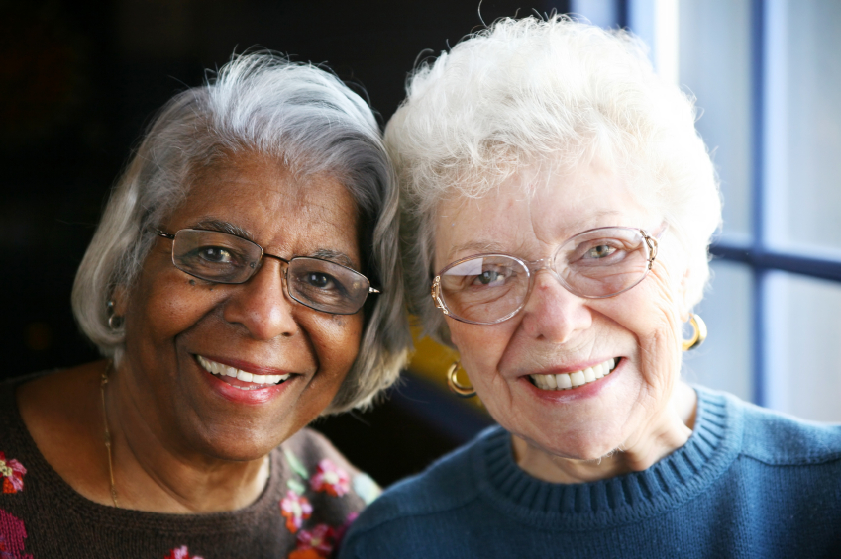
  Topics
  Framing the agenda
  Portfolios highlights
  Impact of COVID
  Strategic positioning

Slide 3

We bring together global experts and expertise to
influence and shape age-related policy to improve the lives of our constituency, and to better all of society.
Driving the Agenda of the
World’s Ageing Population
We are the international advocate for the needs of ageing peoples.
We bring together global experts and expertise to influence and shape age-related policy to improve the lives of our constituency, and to better all of society.

Slide 4
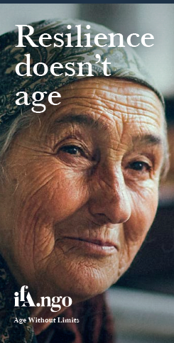
Structural Frameworks
UN Vienna International Plan on Ageing, 1982
** UN Madrid International Plan of Action on Ageing, 2002
UN Millenium Development Goals, 2000-2015
UN Sustainable Development Goals, 2015-2030
**UN Sustainable Development Goals, 2020-2030
** UN High Level Political Forums
** UN Open-ended Working Group (Convention)
WHO World Report on Ageing and Health, 2015
**WHO Global Strategy and Action Plan, 2016
**WHO / UN Decade of Healthy Ageing, 2020-2030
**WHO Global Priorities
** WHO Immunization Strategy 2021-2030
** WHO Vision 2020 Strategy
** WHO Hearing Strategy

Slide 5
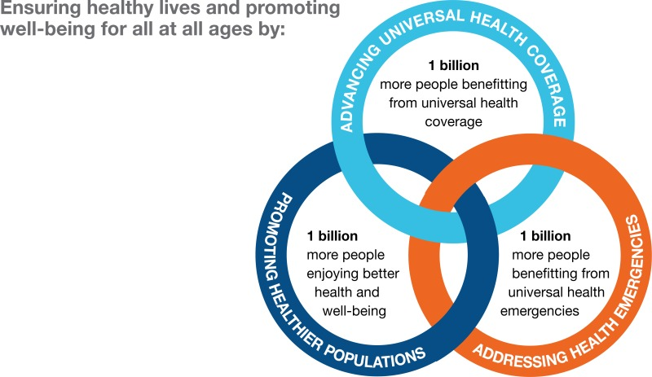
WHO Strategic Priorities

Slide 6
Strategic Goals
2019 - 2021
Credible source of information and evidence
Innovator of platforms that connect and
engage influencers
Influential advocate on ageing matters
Capacity builder across disciplines and sectors
Financially thriving and economically secure organization

Slide 7
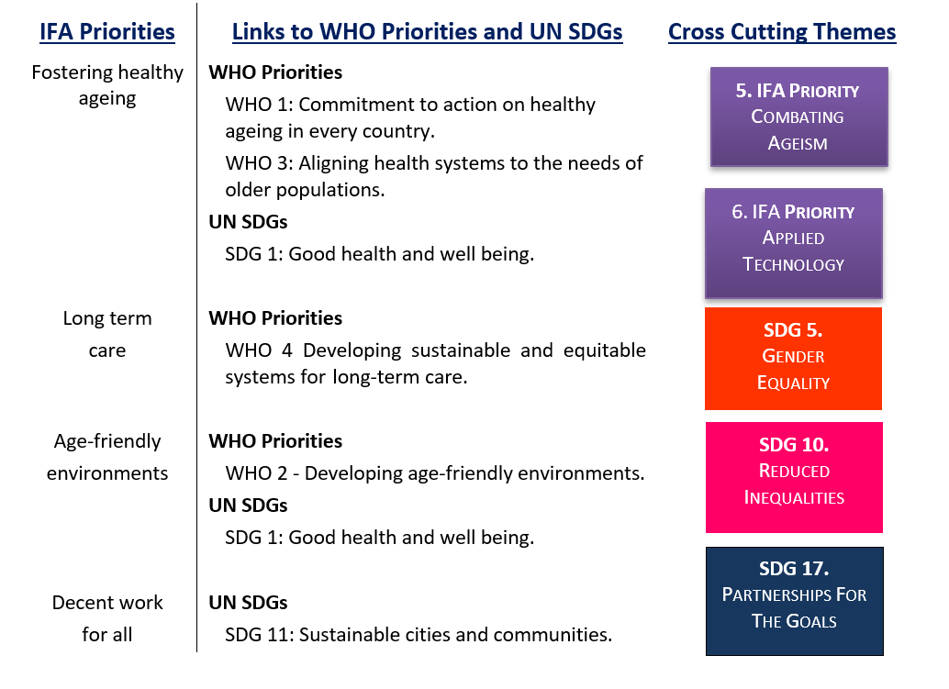
Global Priorities

Slide 8

Portfolios
  Age-friendly cities and communities
  Cognitive reserve
  Hearing
  Oral health
  Vaccination
  Vision health
    Diabetic barometer program
    Biosimilars and biologics
  Conference and events

Slide 9
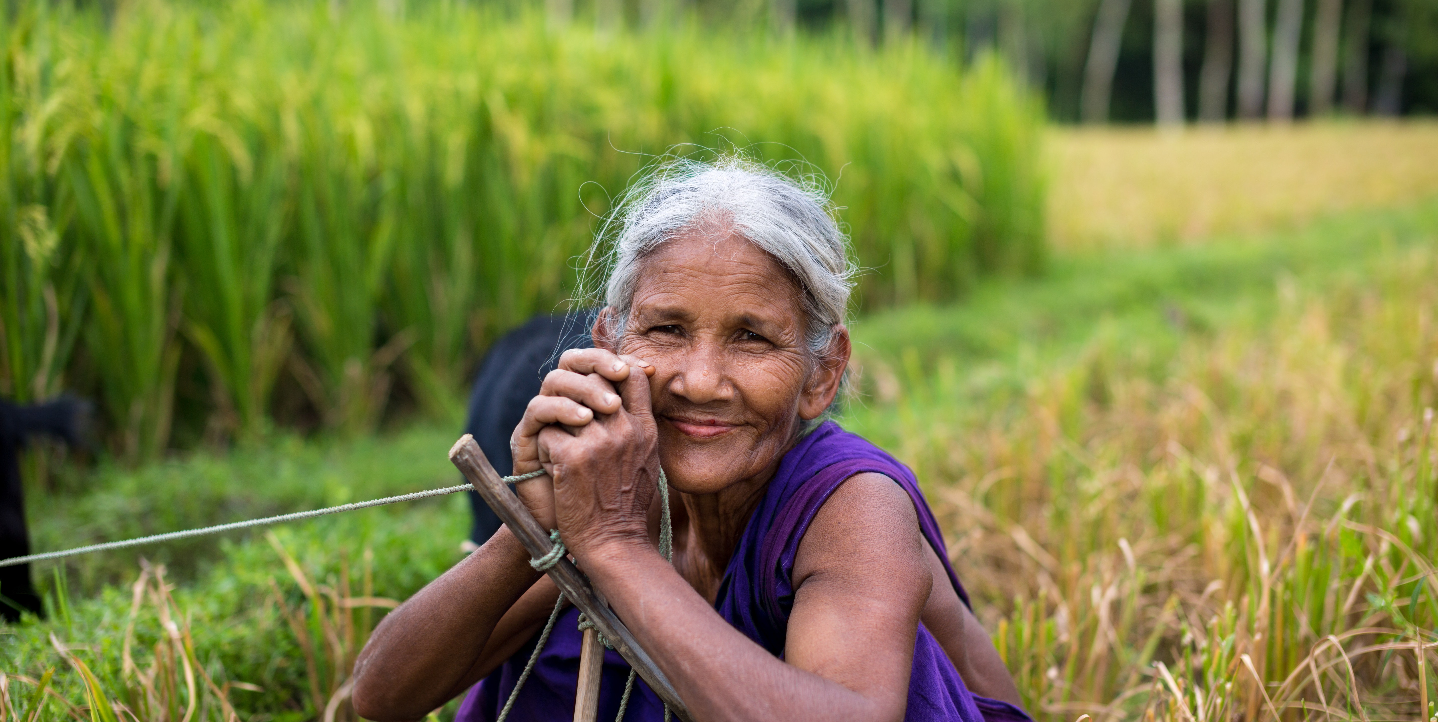
IFA 15th Global Conference
8 - 12th November 2020
Revenue: 200,255
Expenditure:12,362

Slide 10
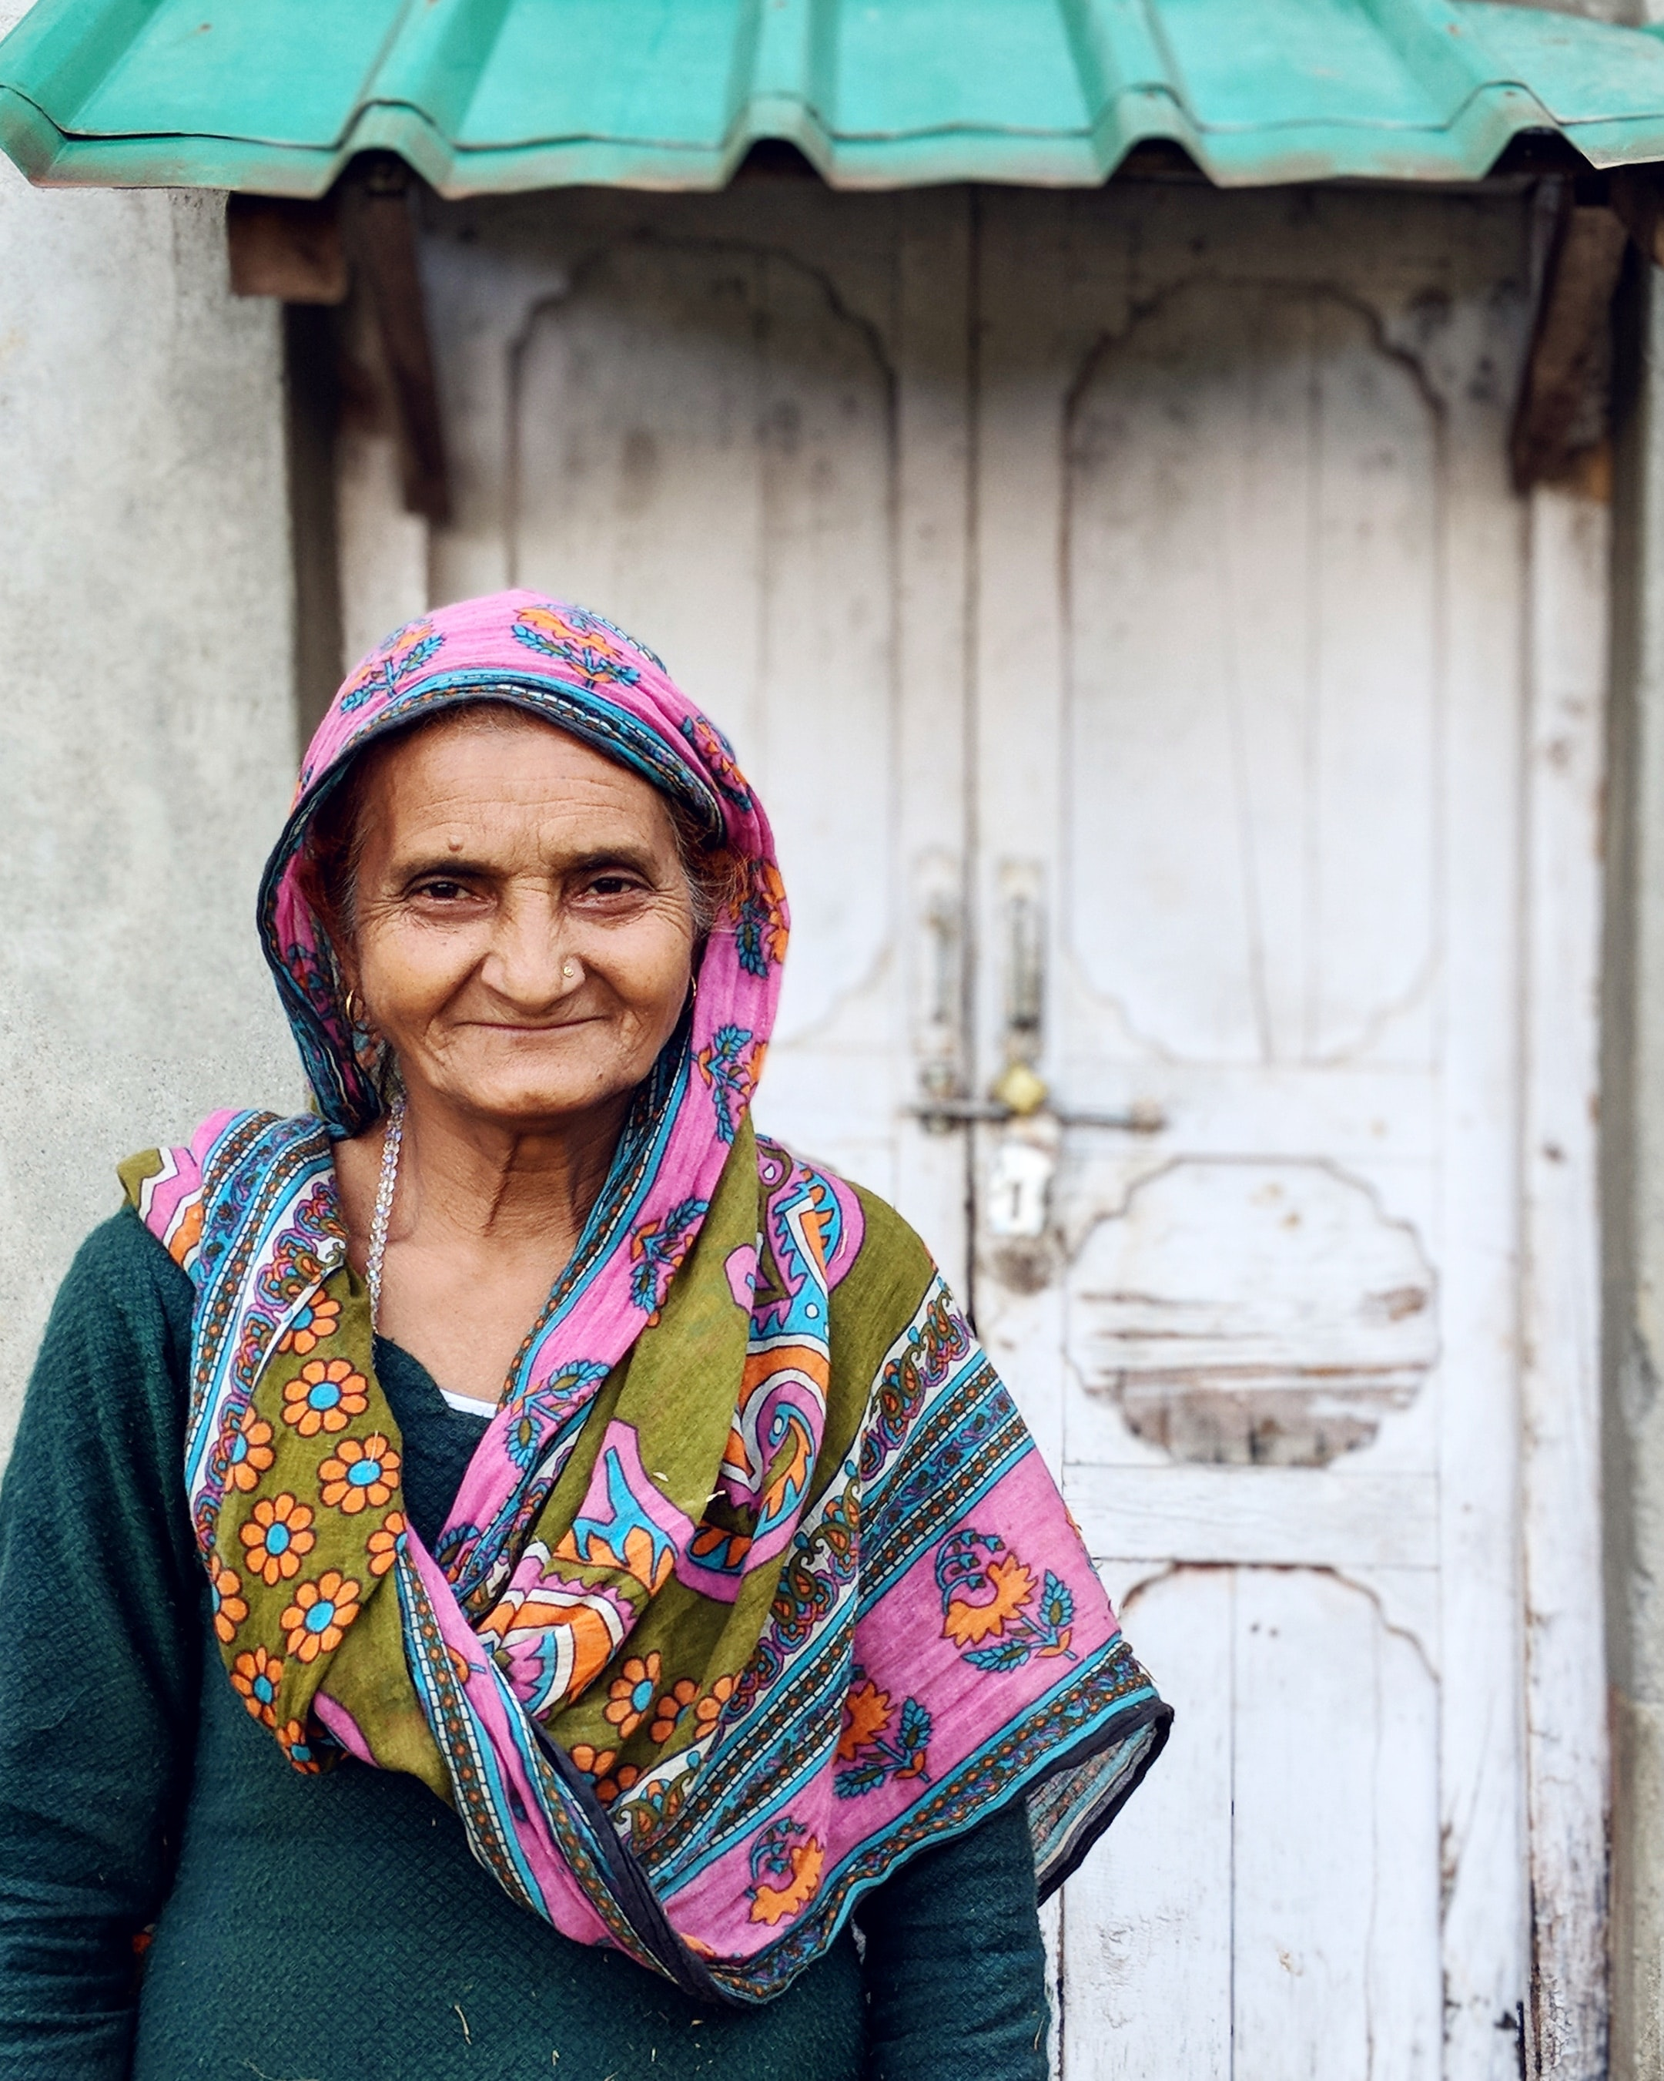
  Current Themes
  Age-friendly Environments
  Combating Ageism
  Addressing Inequality
  Enabling Functional Ability
  Potential Themes
  Age-friendly Environments
  Combating Ageism
  Long term Care
  Integrated Primary Care
  COVID and Older People

Slide 11
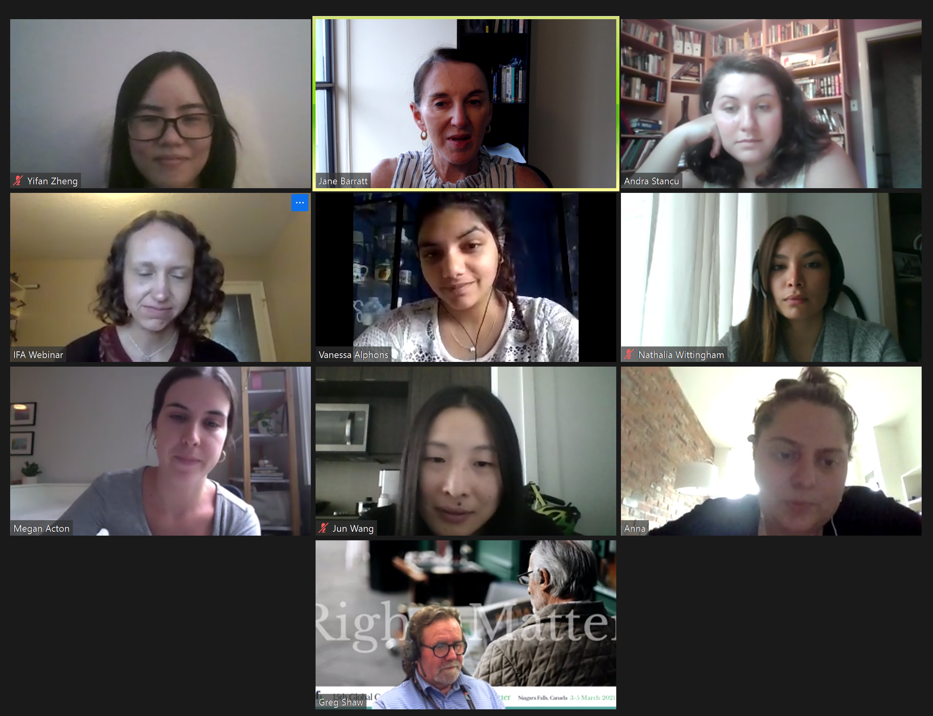

Slide 12
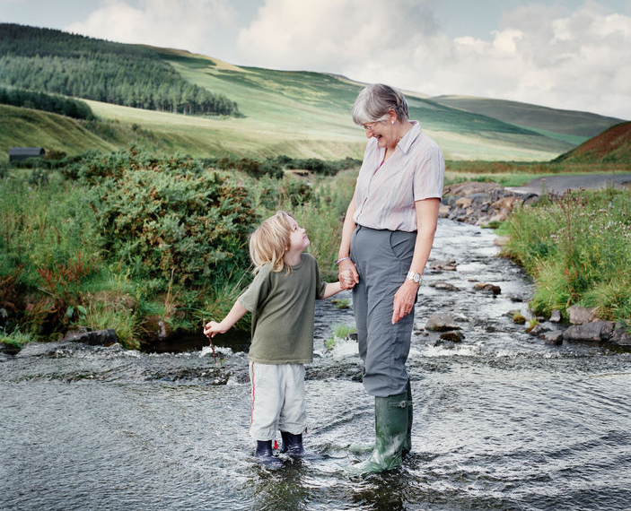
Challenges
And
Opportunities

Slide 13
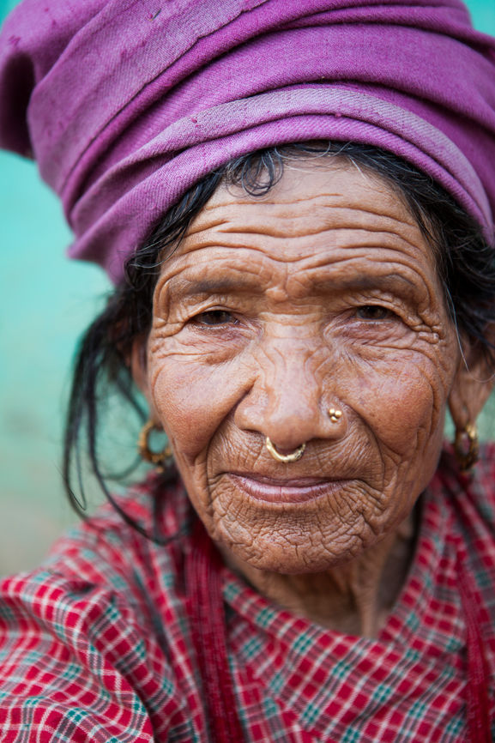
Positioning
  Vaccination through life
  Health system reform
  Investment in health prevention
  Ending inequity
  Vision health
  Social justice

Slide 14
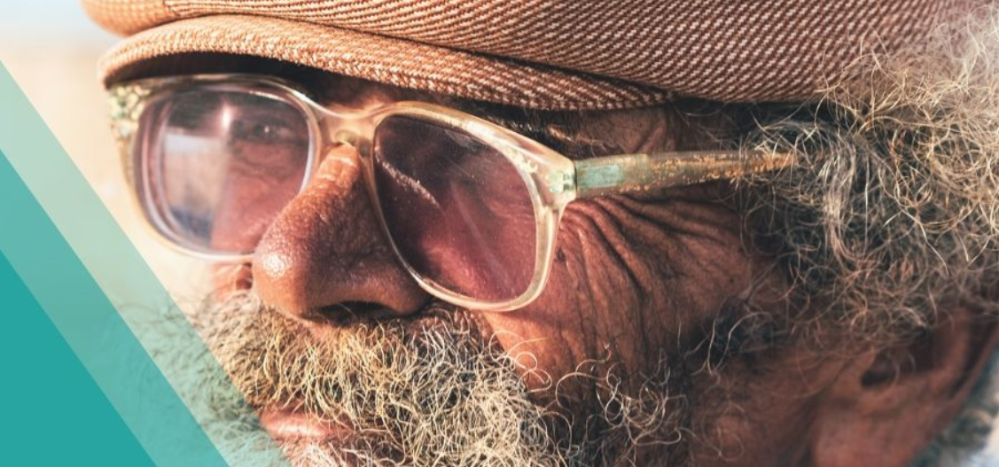
Dr Jane Barratt
jbarratt@ifa.ngo
+1 647 401 7771

