Slide 1
Report
Secretary General

Slide 2


Slide 3

"We might be tired of COVID-19 but it's not tired of us. The virus has no ideology or beliefs; its only goal is to spread."

Slide 4
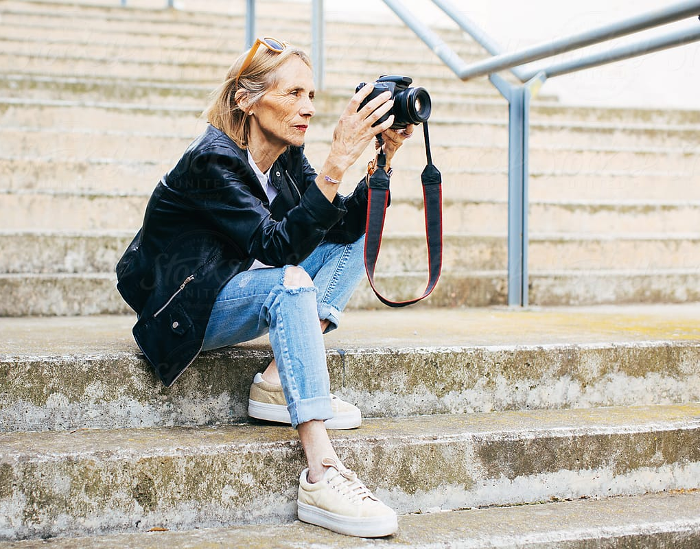
Context for
the Future

Slide 5

Driving the Agenda of the
World’s Ageing Population
We are the international advocate for older people
We bring together global experts and expertise to
influence and shape age-related policy to improve the
lives of our constituency, and to better all of society.
We are the international advocate for the needs of ageing peoples.
We bring together global experts and expertise to influence and shape age-related policy to improve the lives of our constituency, and to better all of society.

Slide 6
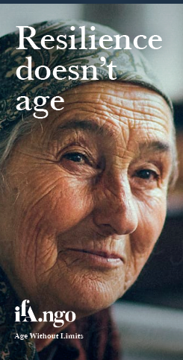
Structural Frameworks
UN Vienna International Plan on Ageing, 1982
** UN Madrid International Plan of Action on Ageing, 2002
UN Millenium Development Goals, 2000-2015
UN Sustainable Development Goals, 2015-2030
**UN Sustainable Development Goals, 2020-2030
** UN High Level Political Forums
** UN Open-ended Working Group (Convention)
WHO World Report on Ageing and Health, 2015
**WHO Global Strategy and Action Plan, 2016
**UN Decade of Healthy Ageing, 2020-2030
**WHO Global Priorities
**UN Decade of Healthy Ageing, 2020-2030
** WHO Immunization Strategy 2030
** WHO Vision 2020 Strategy
** WHO Hearing Report

Slide 7
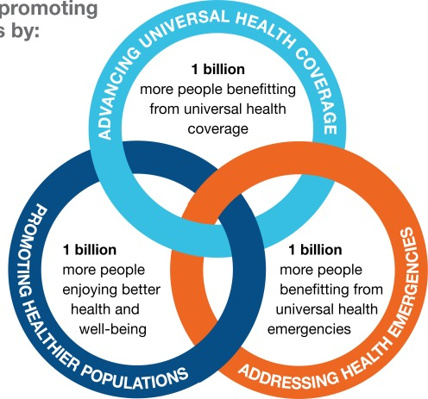

WHO
Priorities

Slide 8

IFA Building Bridges to Drive Change
Decade of Healthy Ageing
Immunisation Strategy 2030
World Vision Report
World Hearing Report
Sustainable Development Goals

Slide 9
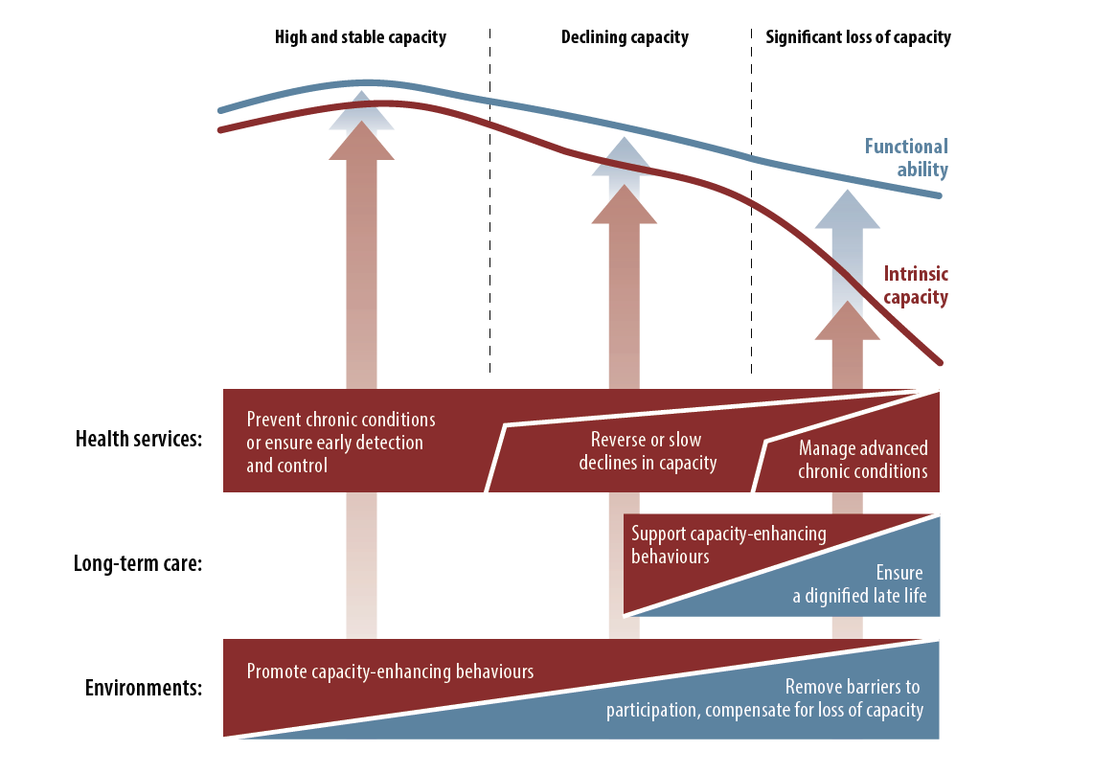
Public Health Framework for Healthy Ageing
WHO. 2015. World Report on Ageing and Health. Available from: http://www.who.int/ageing/events/world-report-2015-launch/en/ Accessed May 30th 2018.

Slide 10
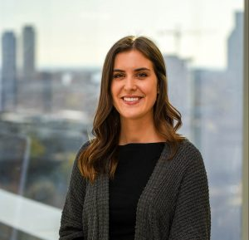
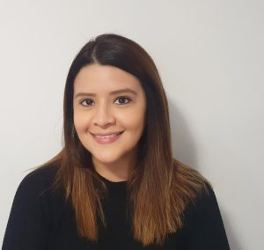
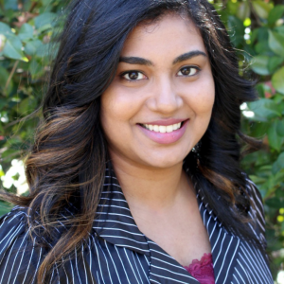
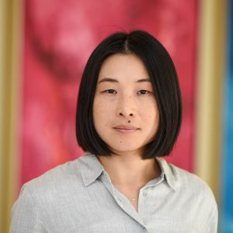


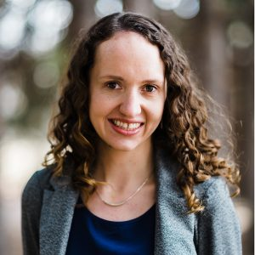
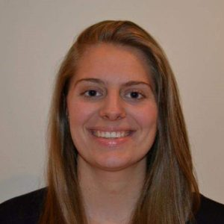

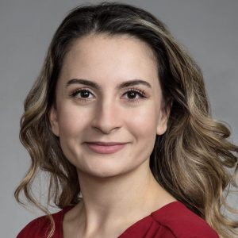
THE IFA TEAM

Slide 11

15TH Global Conference on Ageing
Hybrid model

Slide 12
AV COMPANIES
AV Companies
AV CANADA
FALLSVIEW CASINO (VENUE)
ENCORE

Slide 13
HYBRID MEETING BENEFITS
Reaching more delegates, increasing attendance (face-to-face plus virtual)
Ability to re-watch and share the presentation
Connect to a Global Audience (different time zones)
Address the changing needs of your audience (COVID-19)
Providing new content delivery and communication options
Including people who could not otherwise attend (COVID, busy executives, global attendees, visas not approved, etc.)

Slide 14
OPTION #1 – AV CANADA
 |  | Cost | Including
A | Fully On-site in-Person Event | $95,000.00 pretax | Includes equipment for 12 rooms, setup/dismantle, operate labour, perdiems Note: IFA would be responsible for supplying hotel rooms for our crew.
B | Fully Virtual Event (Platform Only) | $85,000.00 pretax | Includes platform for up to 1000 attendees, 40 hours of programming, help desk, 30 exhibit booths w/ analytics, lounge with 400 meetings @ 15min each, demo for attendees and exhibitors, technical rehearsal with all presenters, 12 technicians for each room, full Production support and a help line for attendees.
 | HYBRID EVENT (Not including Hybrid Equipment | A + B = $180,000 Pre-tax | Option A On-Site In-person Event $95,000 + Option B Fully Virtual Event $85,000.00 + $3,500.00/room/day (Camera, Lighting, Streaming tech, etc). Depending on how many in-person rooms you would like to be fully virtual.
 | Hybrid Equipment | $140,000.00 pretax | Hybrid Equipment: Pre-Conference: 4 rooms x $3,500 = $14,000 Pre-tax Conference : 12 rooms x $3,500 x 3 days: $126.000 Pre-Tax
C | TOTAL HYBRYD EVENT | $320,000 pretax

Slide 15
OPTION #2 AV CANADA + FALLSVIEW
 |  | Cost | Including
A | Fully On-site in-Person Event + Hybrid Equipment | $220,000 | Provided by Fallsview Casino
B | Fully Virtual Event (Platform Only) | $85,000.00 pretax | Provided by AV CANADA
 | TOTAL HYBRYD EVENT | A + B = $305,000 | Including

Slide 16
OPTION #3 Fallsview Casino
Product Subtotal: $274,387.60
Discount: ($94,095.40)
Product Total: $180,292.20
Service Charge: $0.00
Damage Waiver: $0.00
Labor: $16,800.00
Delivery/Misc: $0.00
Tax: $25,621.99
Total: $222,714.19
Fallsview Casino is finalizing the cost of the virtual platform preferred by the IFA.
A final quote will be provided in the coming weeks.

Slide 17
14th Global Conference – 2018
EXPENSES (VENUE + AV)
Venue + Food
Chelsea Hotel | 146,136.16
Ryerson theatre | $ 24,132.50
Ryerson Classrooms | $ 43,692.42
Ryerson food | $ 3,672.50
 | $ 217,633.58
AV
Pure AV (translation inclided) | $ 69,568.64
Decore & More (White Chairs) | $ 1,101.75
Ryerson Theatre: for plenaries | $ 24,132.50
Freeman - Poster Boards - Power | $ 5,993.29
 | $ 100,796.18
Total | $ 294,297.26

Slide 18
15th Global Conference – 2021
15th Global Conference on Ageing
Venue + Food
Fallsview Casino + Hilton | $ 135,000.00
 | $ 135,000.00
AV HYBRID MODEL
AV for all concurrent sessions Management system Translations (French-English) New Convention lighting package + Chairs Stage for plenaries Digital Screens 10 Poster Presentations Exhibitor booths 30 All hybrid Equipment + Virtual Platform
 | $222,714.19
Total | $357,714.19

Slide 19

Portfolios

Slide 20



Slide 21



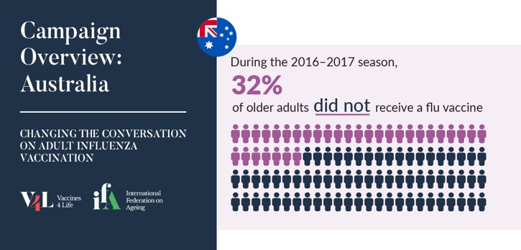

Slide 22


European Scientific Working group on Influenza

Slide 23


Slide 24

United Nations and
World Health Association

Slide 25


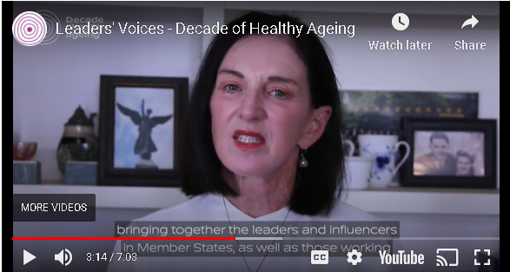
UN Decade of Healthy Ageing

Slide 26


International Day of Older People

Slide 27

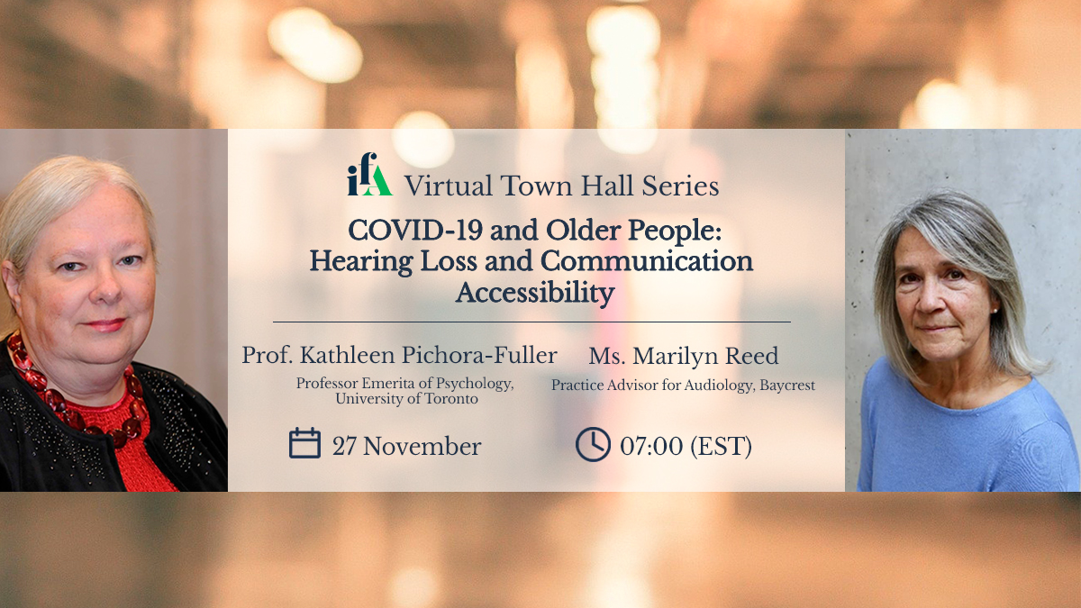

IFA Town Halls

Slide 28


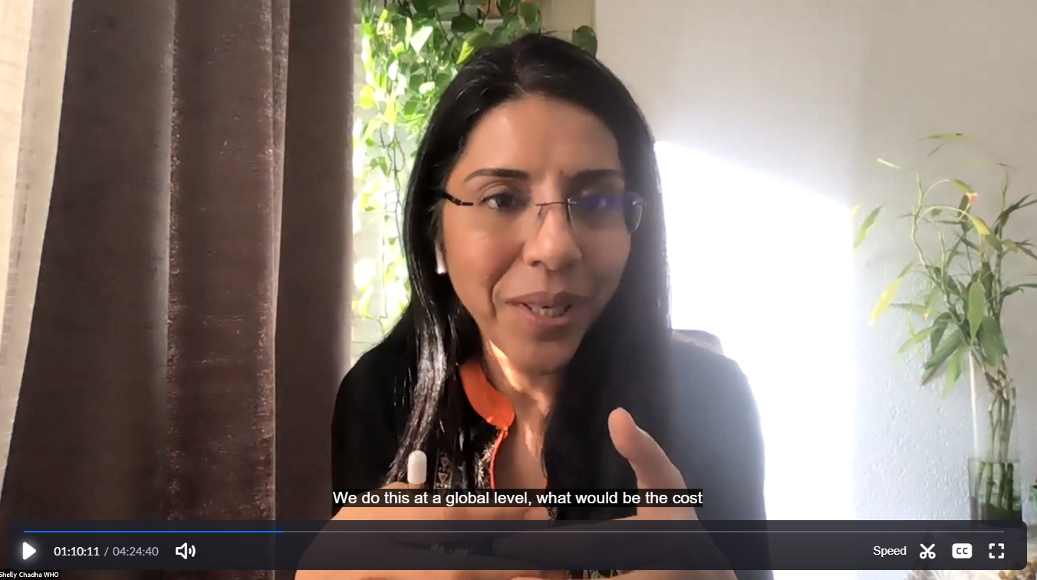
Hearing health

Slide 29
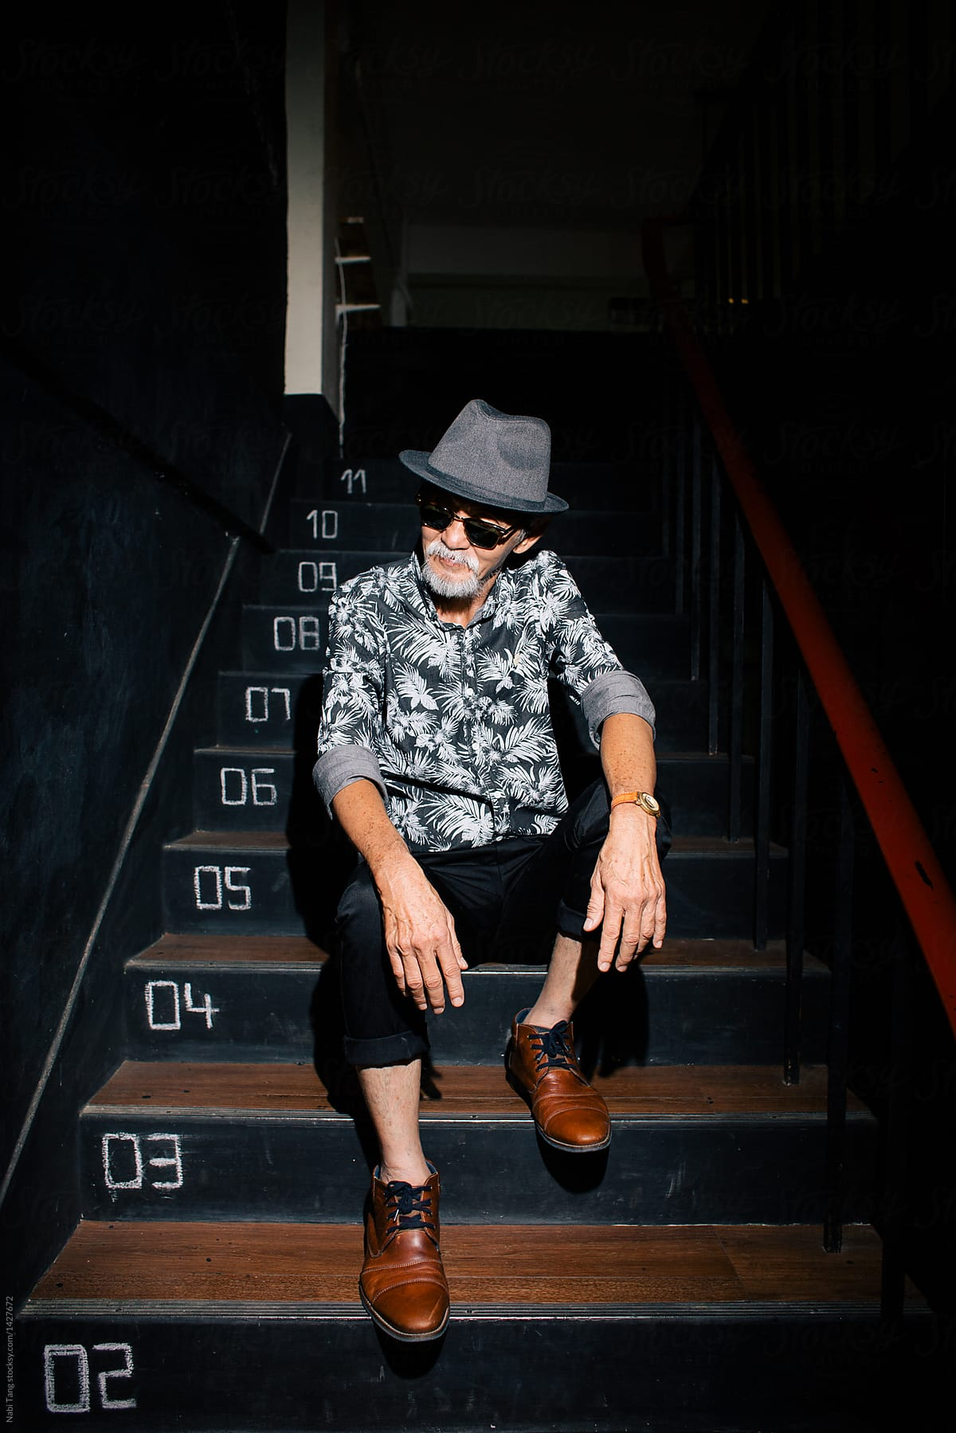
What is the IFAs modus operandi?

Slide 30
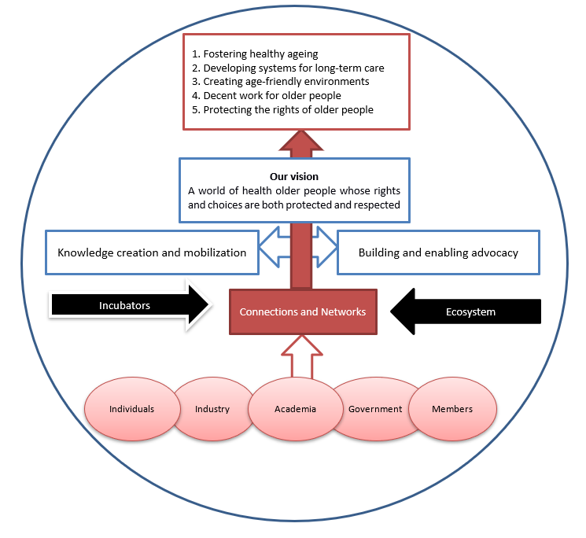
Building an
IFA portfolio

Slide 31

Strategic Goals
2021 -
Credible source of information and evidence
Innovator of platforms that connect and
engage influencers
Influential advocate on ageing matters
Capacity builder across disciplines and sectors
Financially thriving and economically secure organization

Slide 32
Work
LTC
Age-friendly
Ageism
Inequity
Systems
Vision
Hearing
Oral Health
Cognitive Health
Vaccination

Slide 33

Basis for Strategic Direction

Slide 34
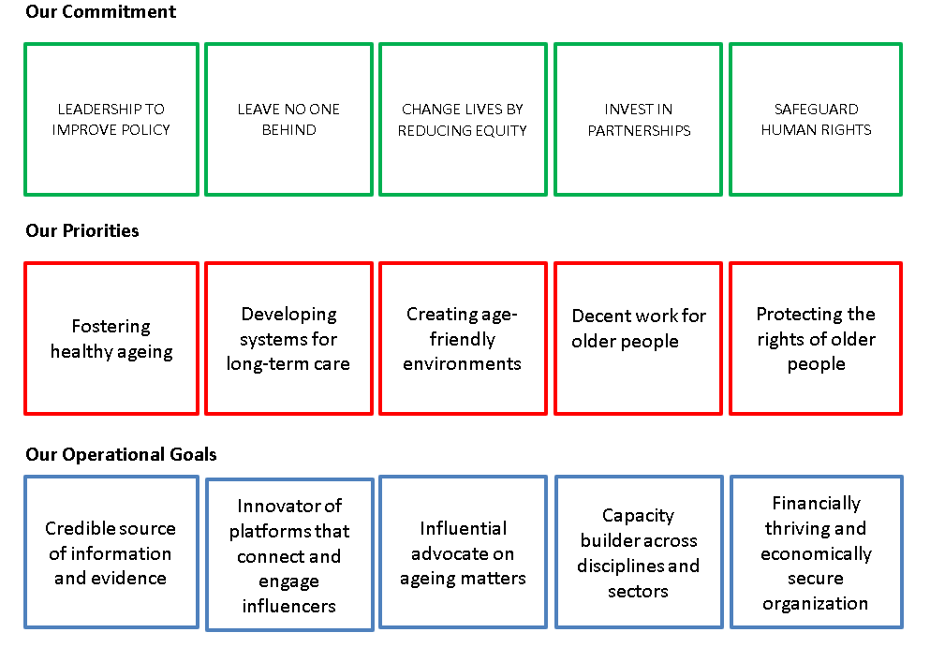
Our Commitment Priorities and Goals

Slide 35
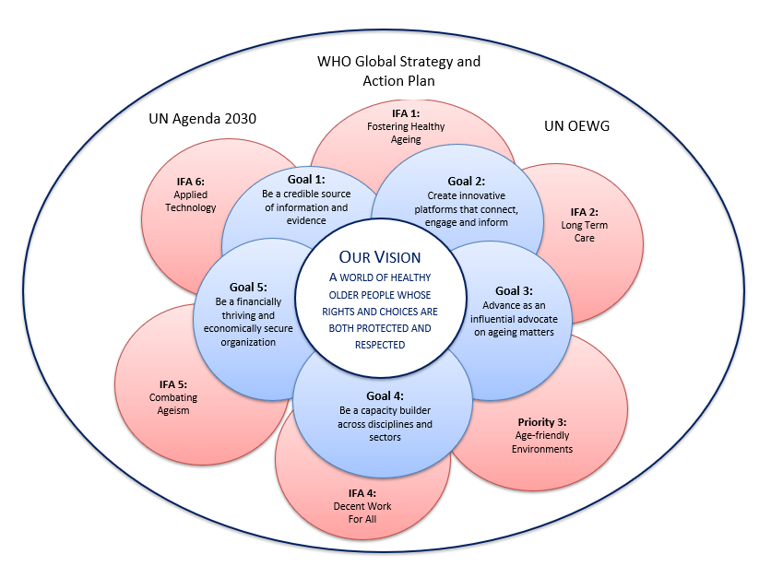
IFA Strategic Goals
2019 - 2021

Slide 36
WPD - 2016, 2017
20 November, 2016
Expert Meet WHO
Vertical Advocacy
2015-19
22 March, 2017
IFA 2018 Global Conf
08 August, 2018
WHA 69th - IFA IFPMA ICN
WHO Immunisation 2021-2030 Strategy
27 April, 2017
23 May, 2019
IAGG - Expanding Perspectives on VPD
24 July, 2017
IFA UN Event - Adult Vaccination
WIW - 2016 - 2019
13 February, 2016
24 April, 2019
World Health Summit - Vaccine Apathy
IFA 2016 Global Conf
16 October, 2017
23 June, 2016
2015
2015
2016
2017
2018
2019
2019
0 minutes
Today
30 September, 2015
WHO Report on Ageing and Health
0 minutes
26 May, 2016
WHO Global Strategy and Action Plan
0 minutes
21 October, 2015
UN Sustainable Development Goals
0 minutes
20 November, 2017
WHO Draft GPW13 Plan 2019–2023

Slide 37
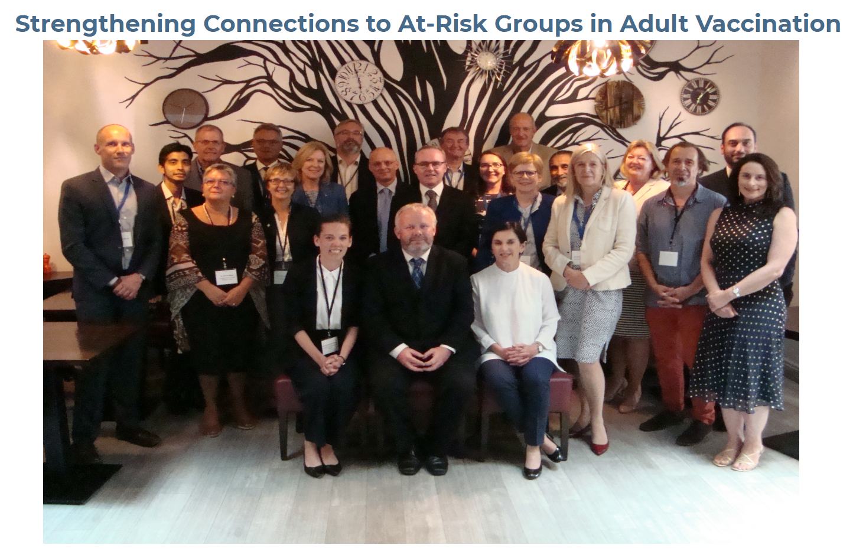
IFA - At-Risk Diabetes Meet
Horizontal Advocacy
2015-19
EICA - 2017 and 2018
May 24, 2017
Sep 6, 2018
EUGMS - Adults and Pertussis
Sep 21, 2017
EUPHA - Role Adult Vaccines
Nov 11, 2017
IFA EU submission
Dec 20, 2017
IFA Scientists Summit
IFA - Public Health and At-Risk Meet
Jun 17, 2015
Aug 29, 2017
IFA NGO Summit
IFA PIP Statement to JCVI
Nov 6, 2015
Jan 29, 2018
IFA - Nordic At-Risk Meet
Jan 17, 2018
EU Health Awards 2017
IFA - At-Risk Heart and Lung Meet
Apr 17, 2017
IFA Champion Summit
Nov 10, 2015
Nov 11, 2018
2015
2015
2016
2017
2018
2018
0 minutes
Today
Jan 18
IFA Expert Advisory Com
0 days
Apr 1
EU Council Recommendation

Slide 38
Communicating our Agenda

Slide 39


Slide 40
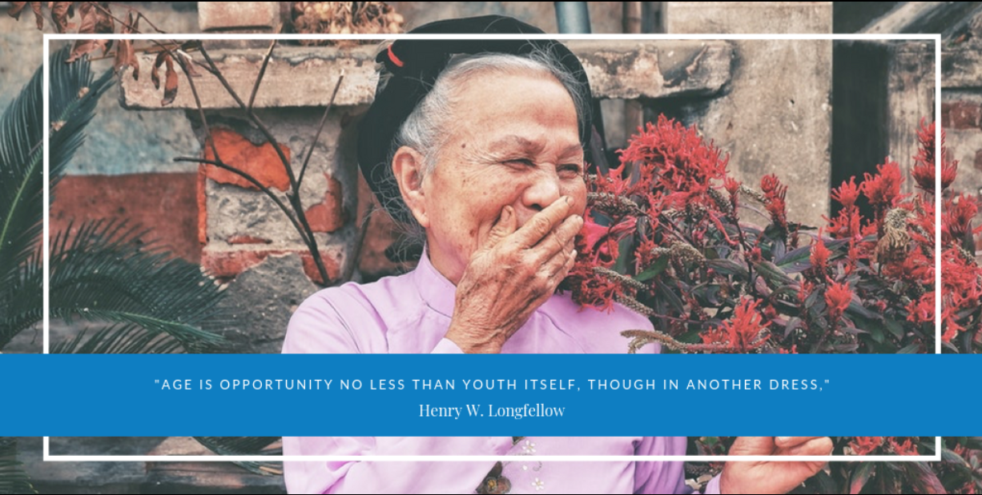
Be inspired!

