Slide 1
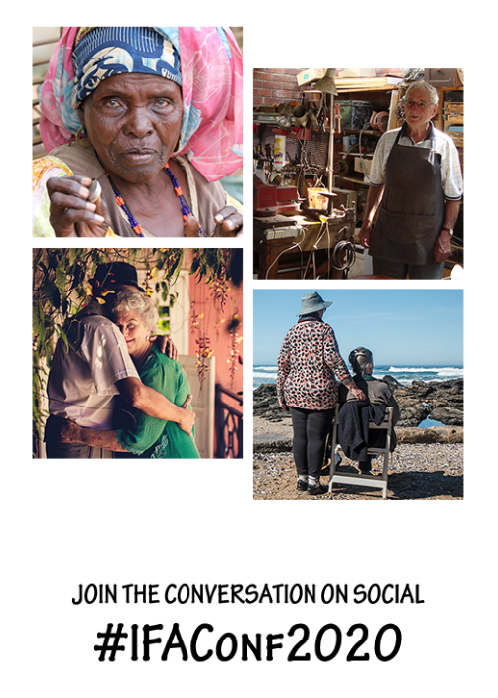

IFA 15th Global Conference on Ageing, Niagara Falls
1st - 3rd November 2020

Slide 2
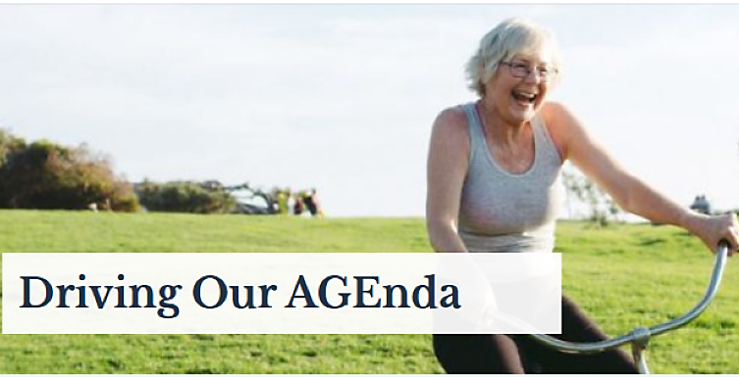

Slide 3

Driving the Agenda of the
World’s Ageing Population
We are the international advocate for older people
We bring together global experts and expertise to influence and shape age-related policy to improve the lives of our constituency, and to better all of society.
We are the international advocate for the needs of ageing peoples.
We bring together global experts and expertise to influence and shape age-related policy to improve the lives of our constituency, and to better all of society.

Slide 4

#RIGHTS MATTER

Slide 5
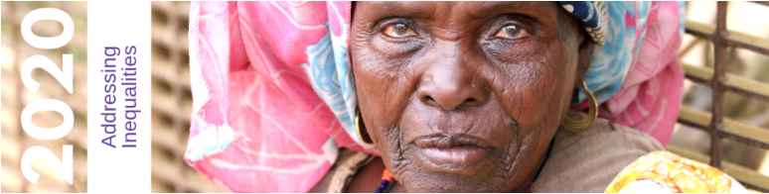


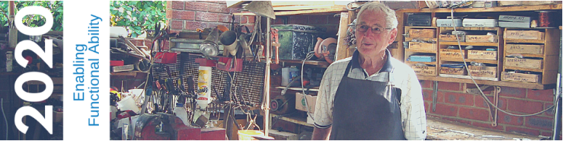
Identity, Inequality and Ageing
Migration and Displacement
Poverty and Financial Insecurity
Access to Health and Social Services
Access to Work and Reshaping Retirement
Social Isolation, Loneliness and Abuse
Age friendly Cities and Communities
Technology, Innovation and Ageing
Housing and Urban Planning
Brain and cognitive health
Innovations in Long-Term Care
Maximizing Senses

Slide 6
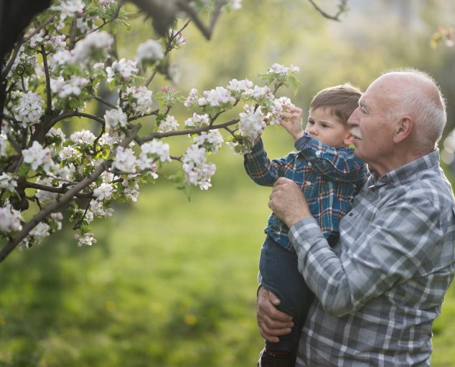
Age-friendly Summit
31st October 2020
One day stand-alone event
Measuring impact
Showcasing AFC models of good practice
Building the sustainability
Leadership in voices of older people
Dementia-friendly and age-friendly
AFC and combating ageism

Slide 7
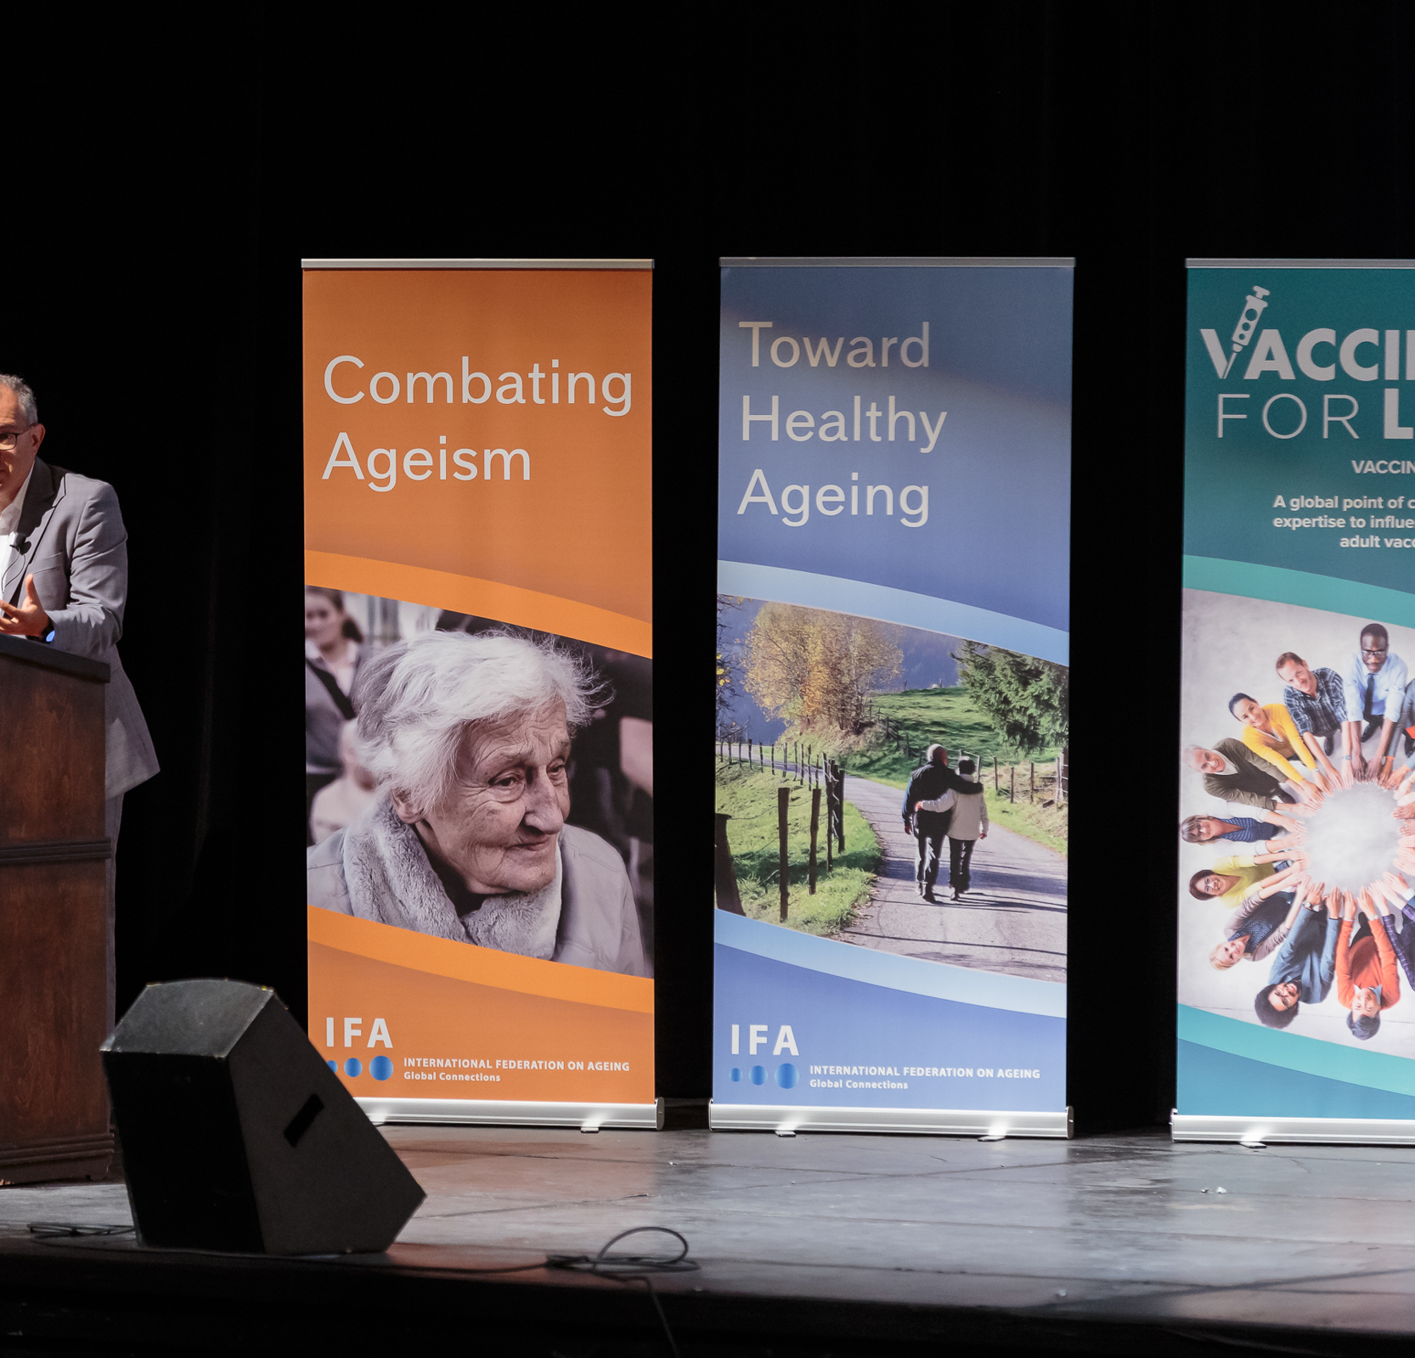
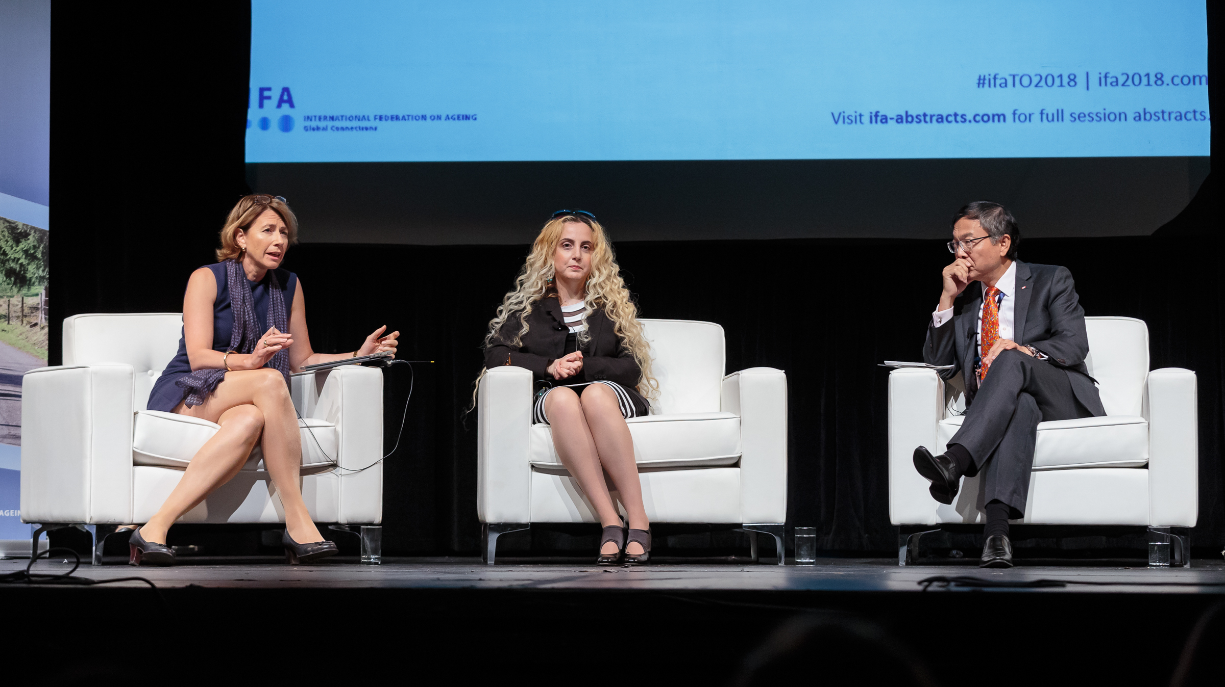
Plenary

Slide 8
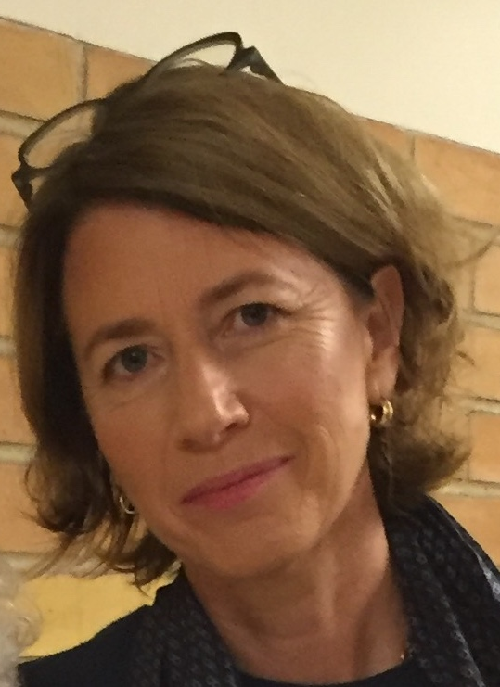

OPENING KEYNOTE ADDRESS
Ms Alana Officer, Senior Health Advisor at the WHO
Alana has led the development of the Decade of Healthy Ageing and is responsible for the WHO Global Network of Age-Friendly Cities and Communities.

Slide 9
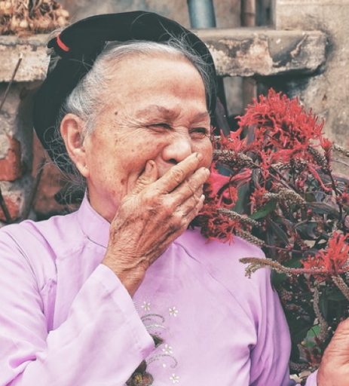
Age-friendly Global Village
The Village is a marketplace to
Connect and share information
Showcase city and community AFC practices
Meet one other informally
Ask questions on a one-to-one basis and discuss in detail aspects of the AFCC program
Network in a colorful and relaxed setting.

Slide 10
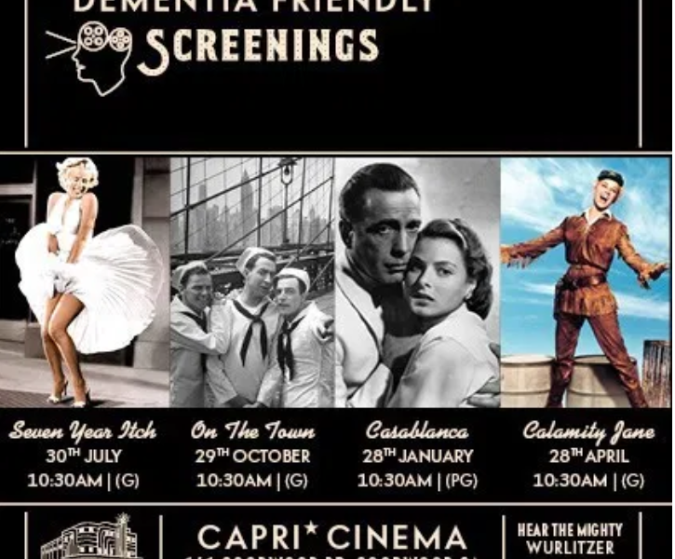
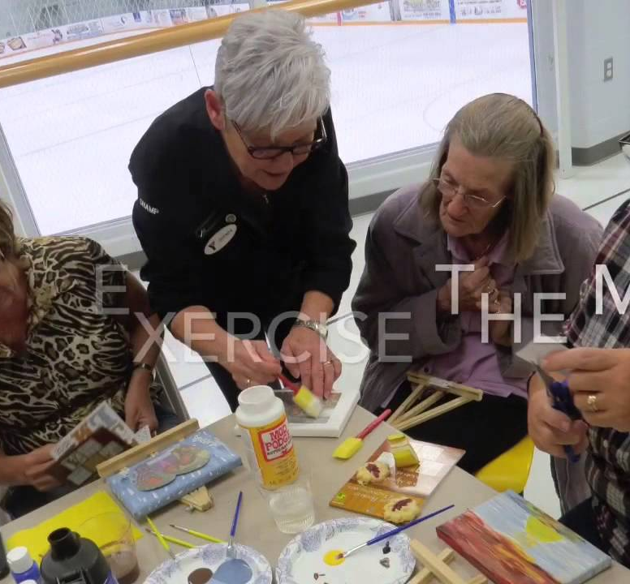

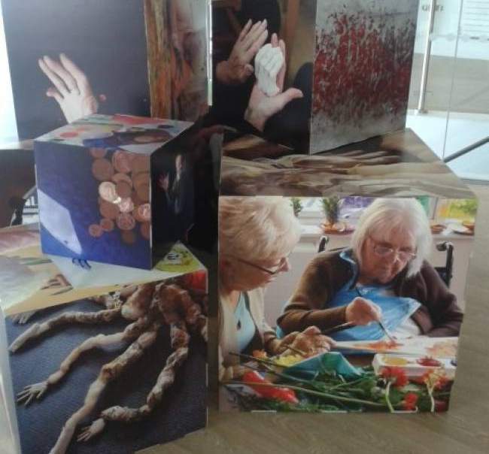
Age-friendly
Conference
Sessions

Slide 11
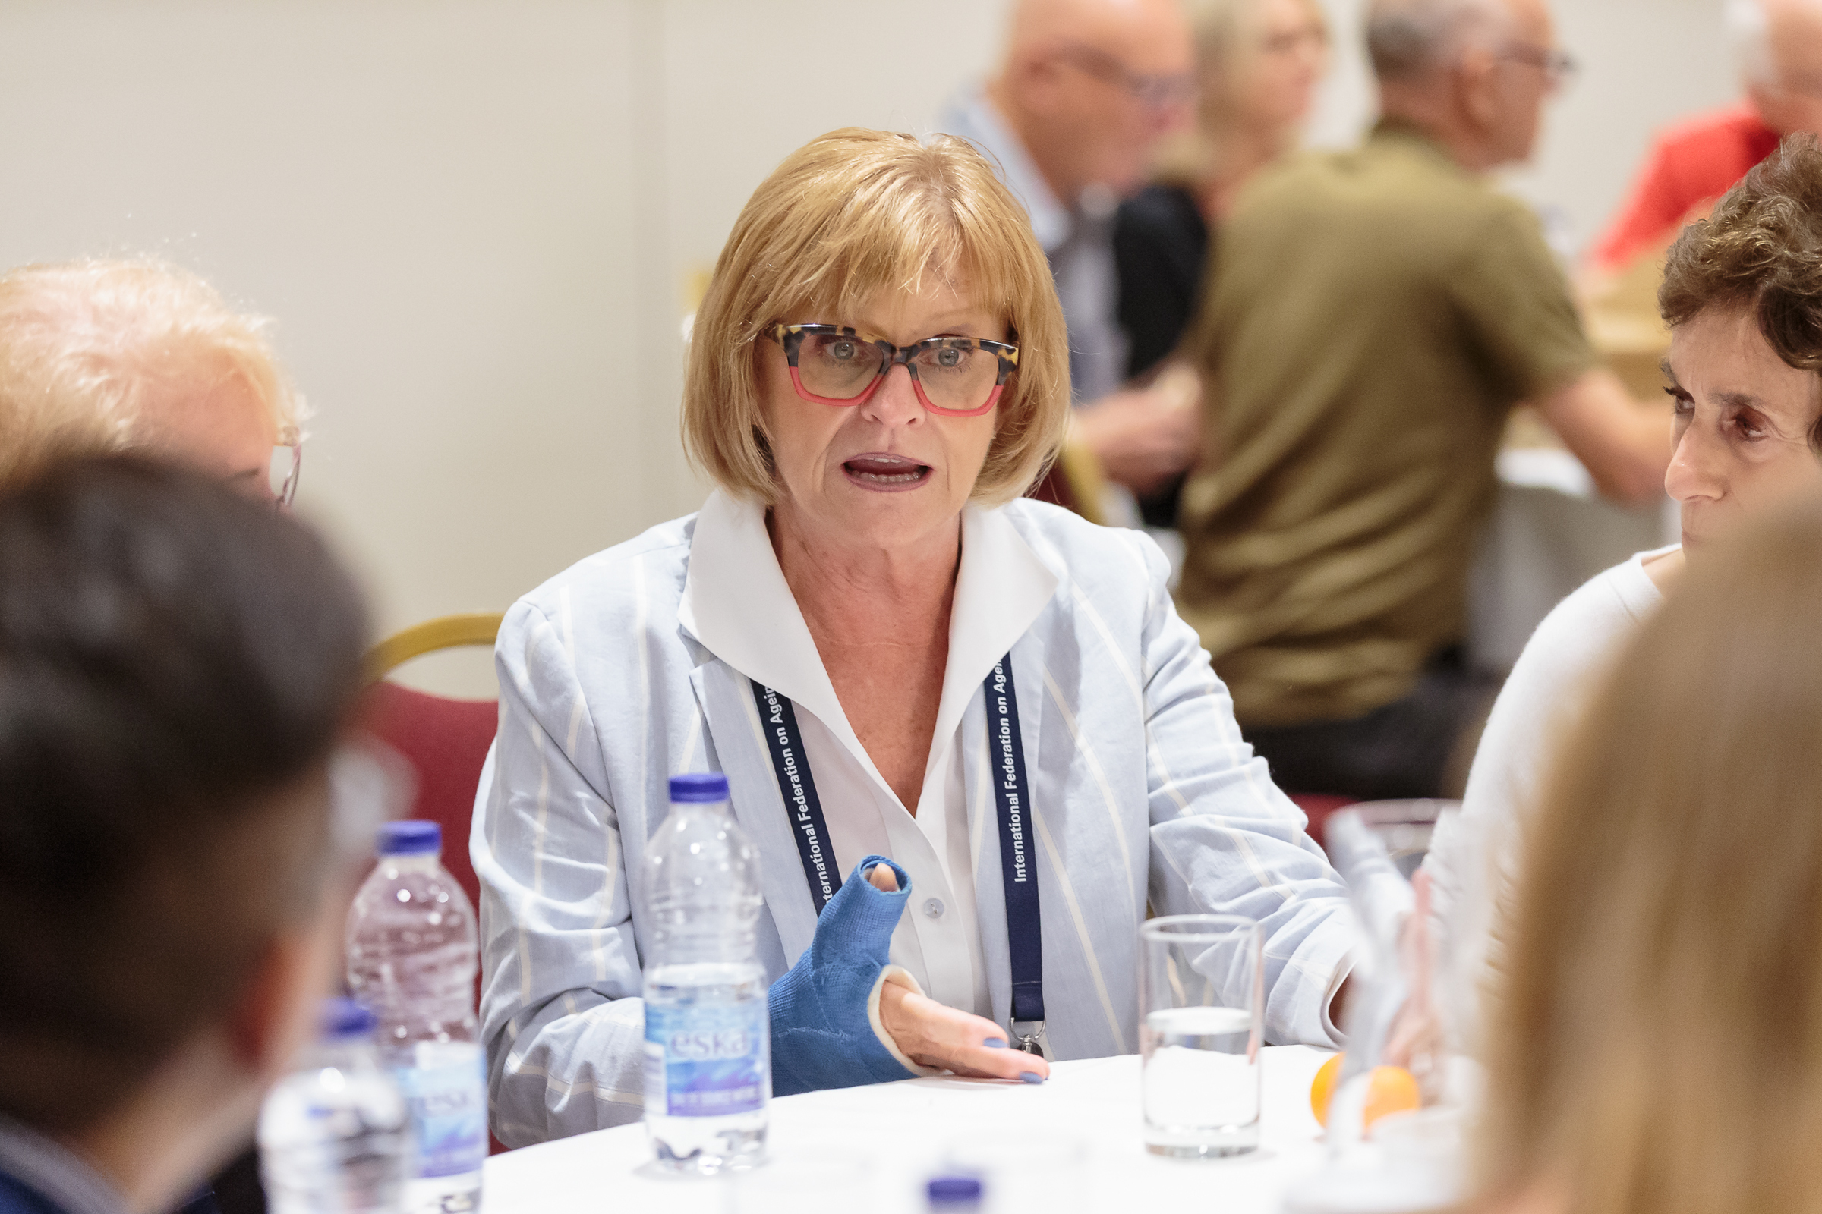
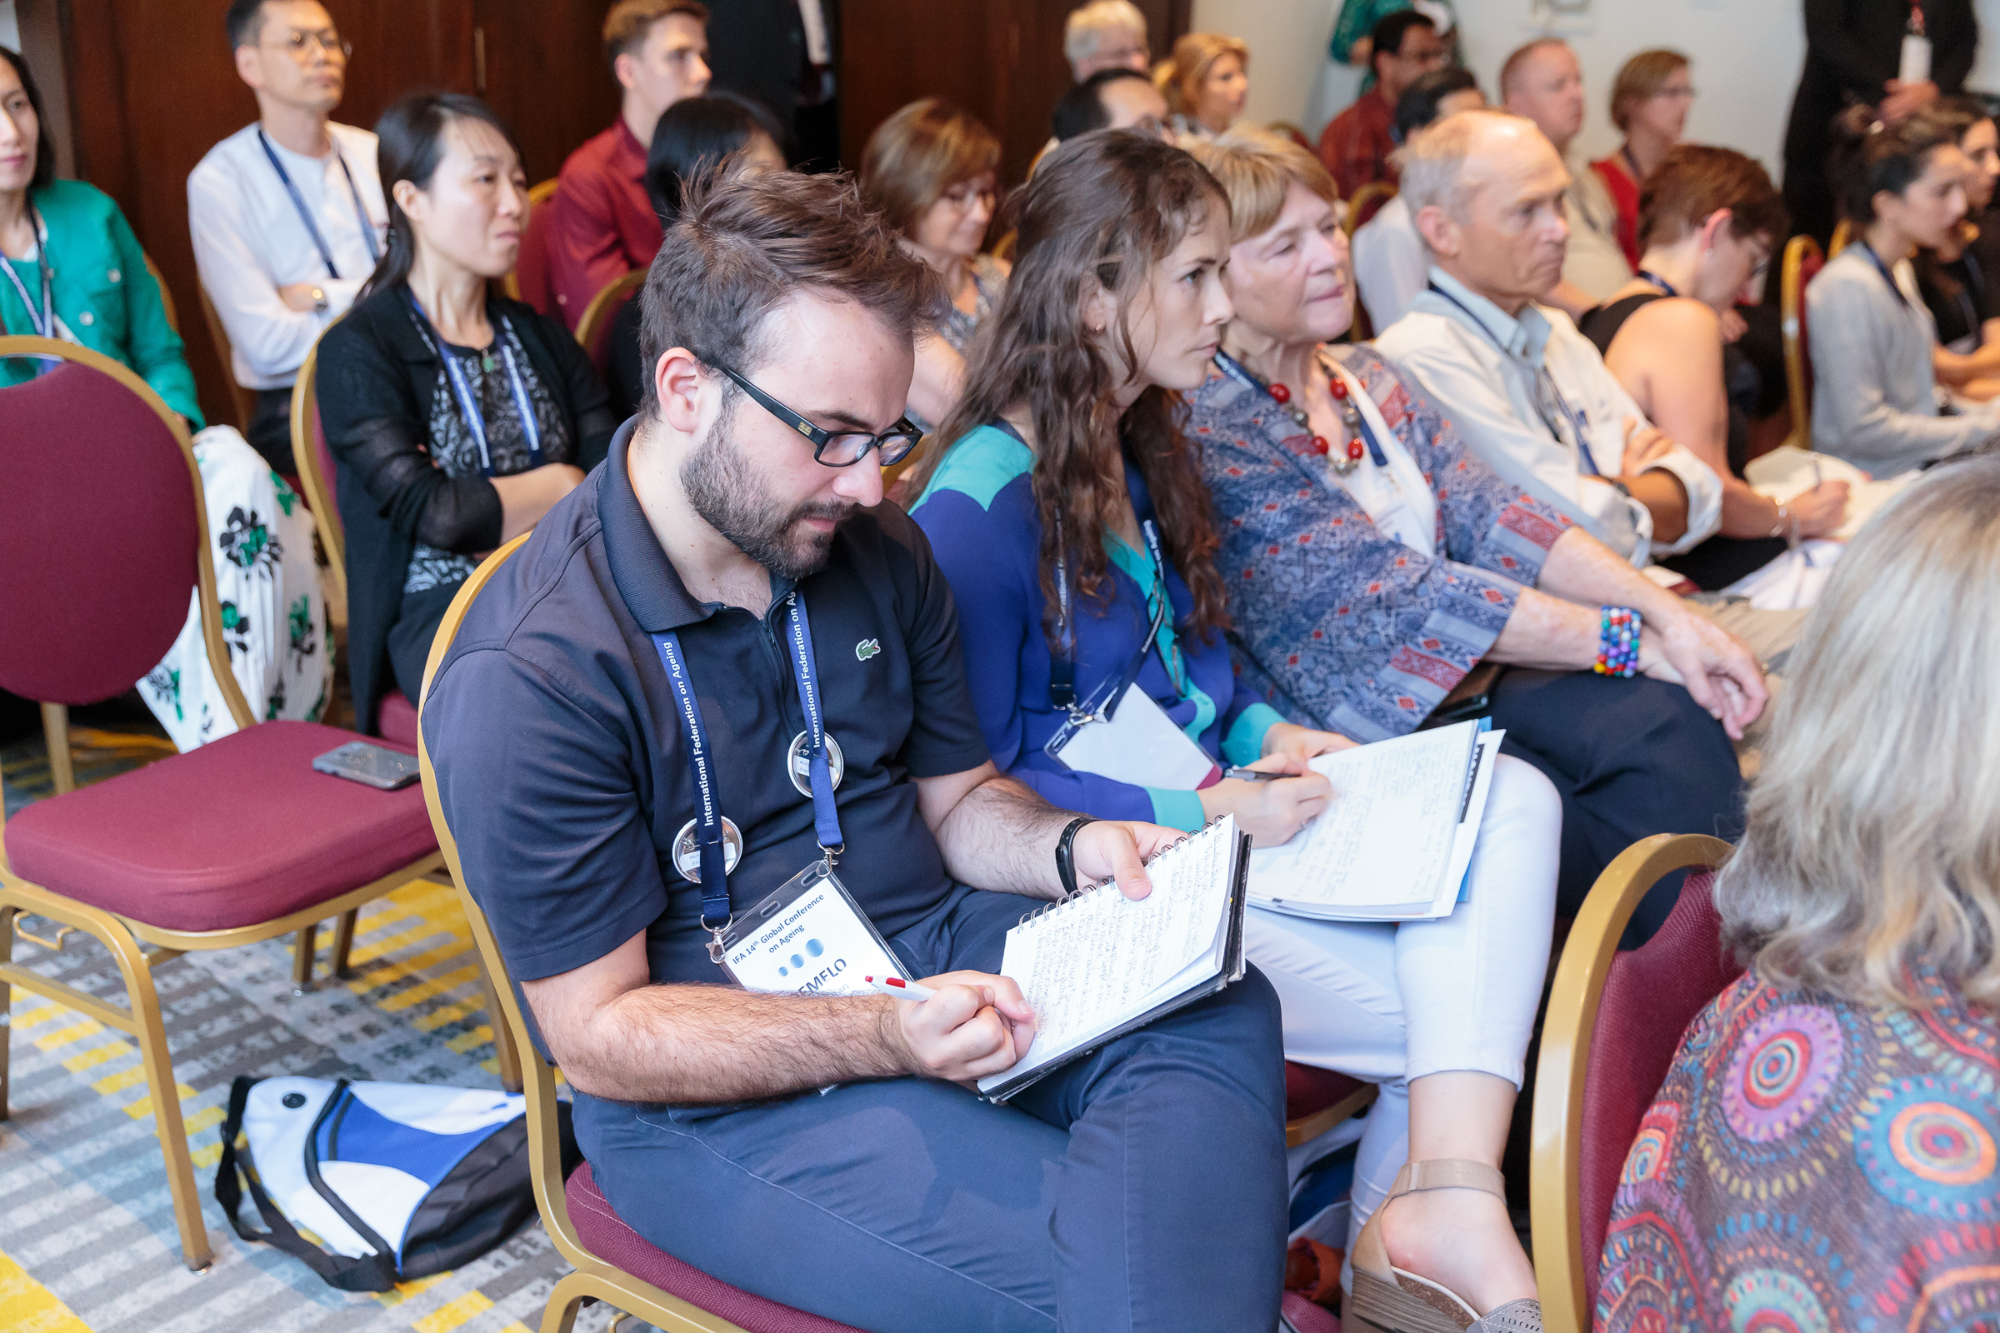
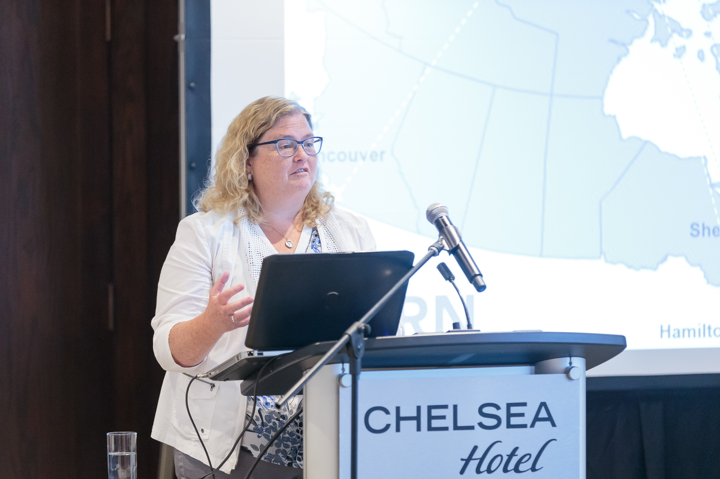
Age-friendly
Paper Sessions
15mins plus questions

Slide 12
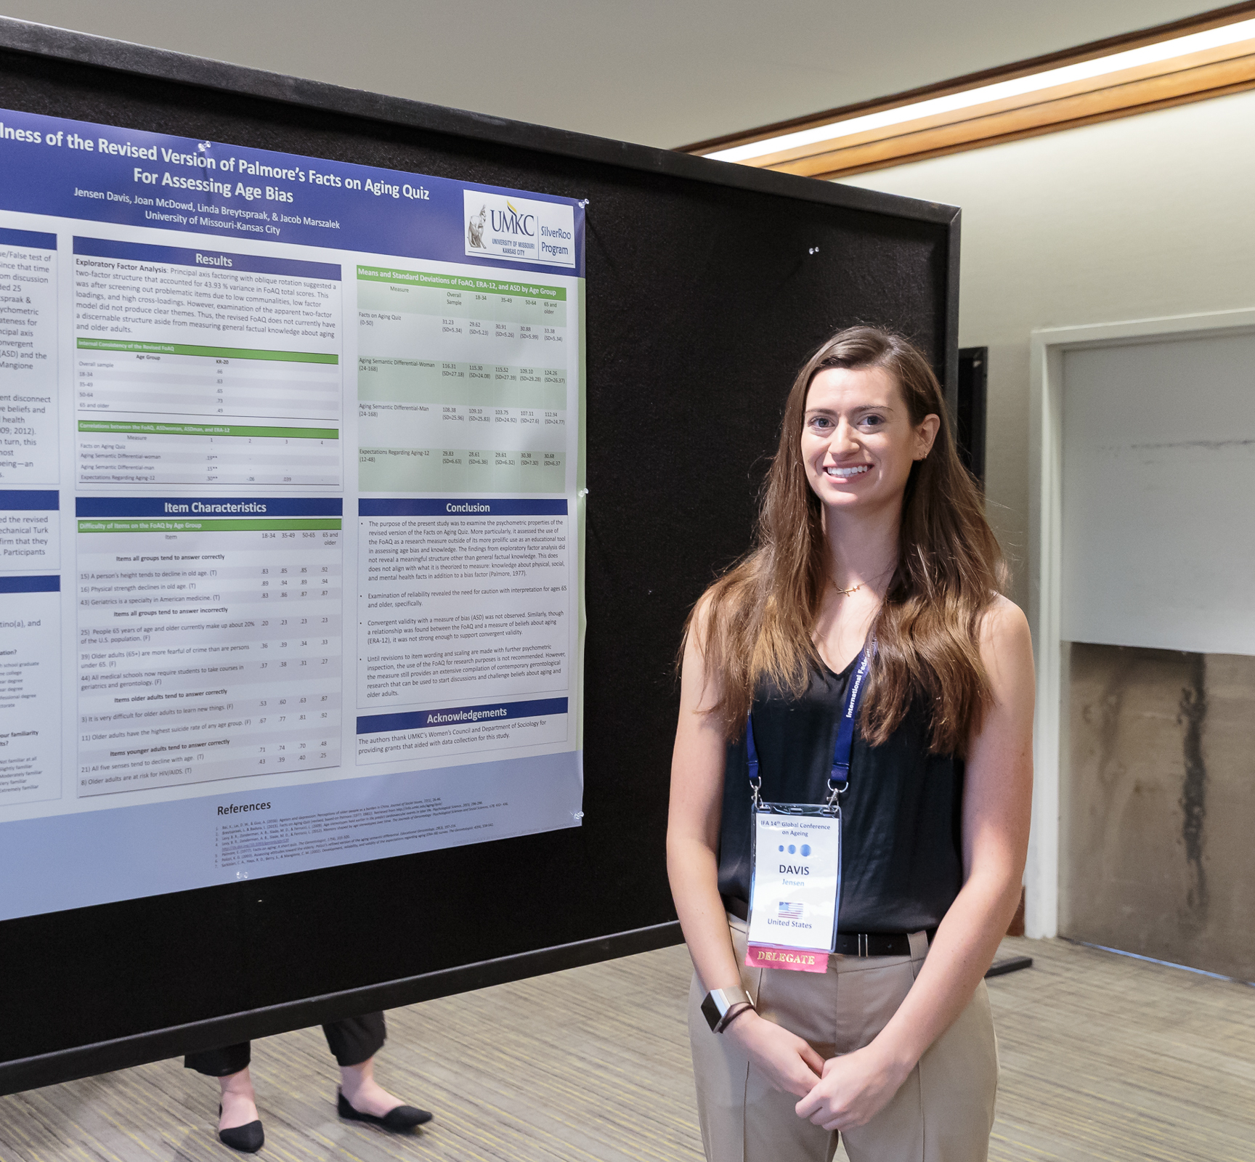
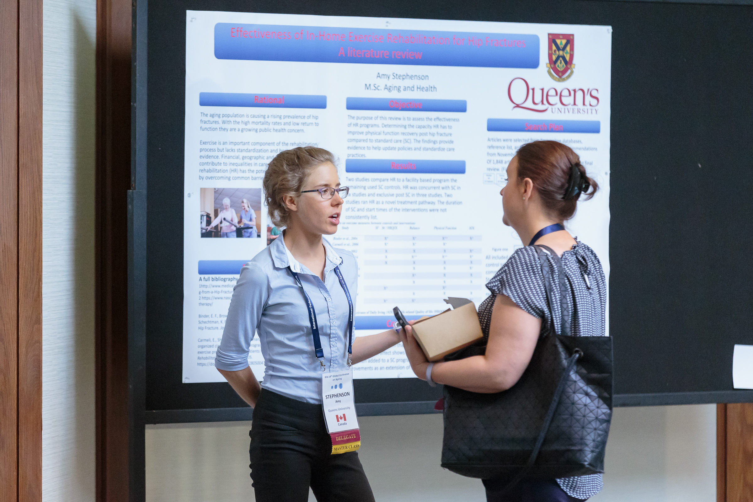
Age-friendly Poster Sessions

Slide 13
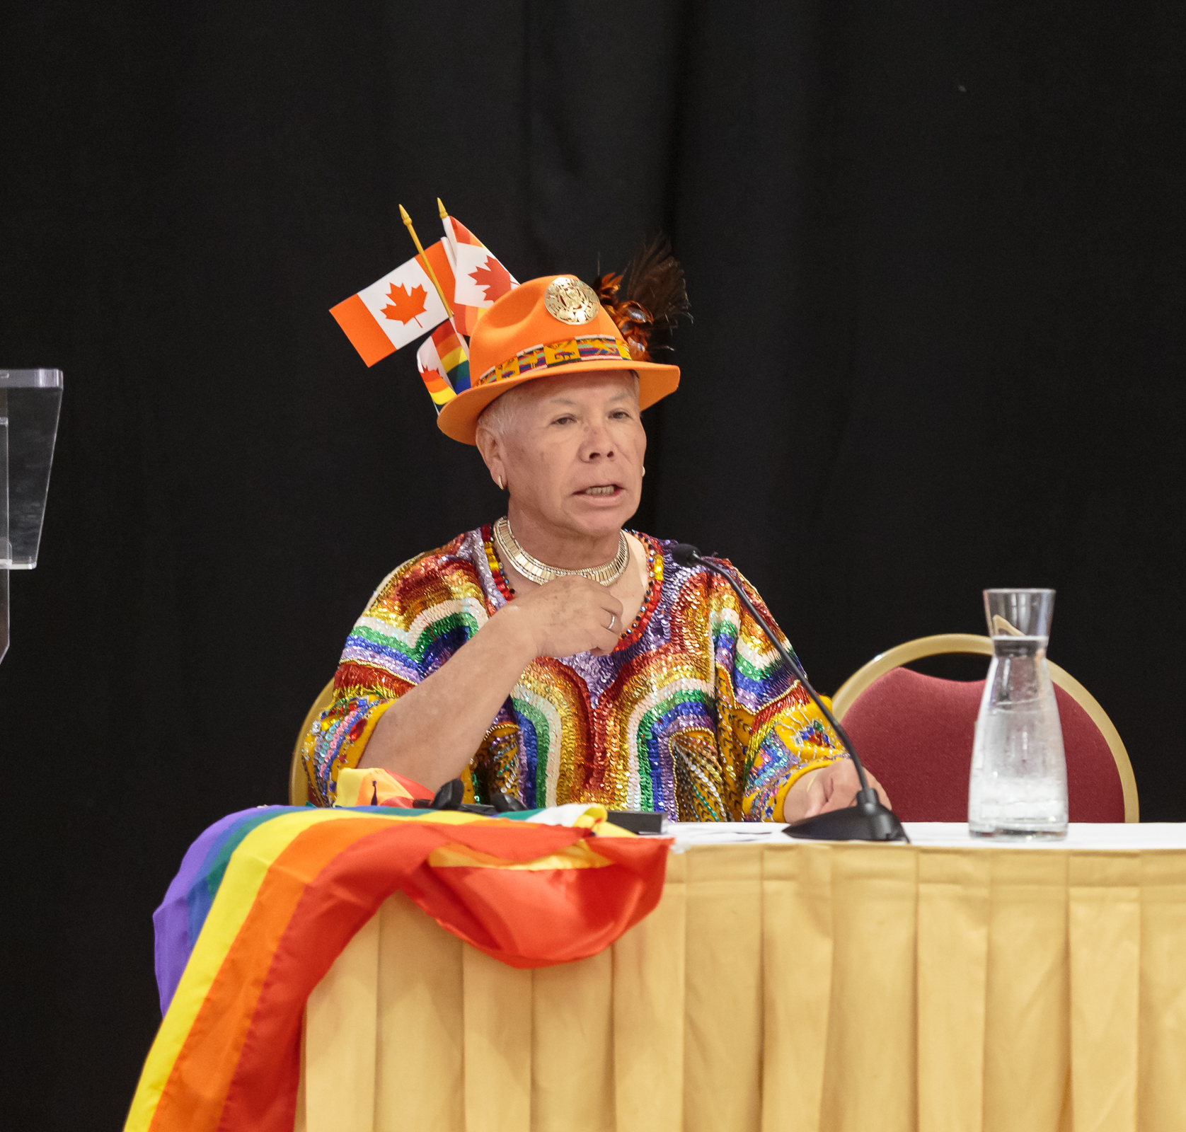
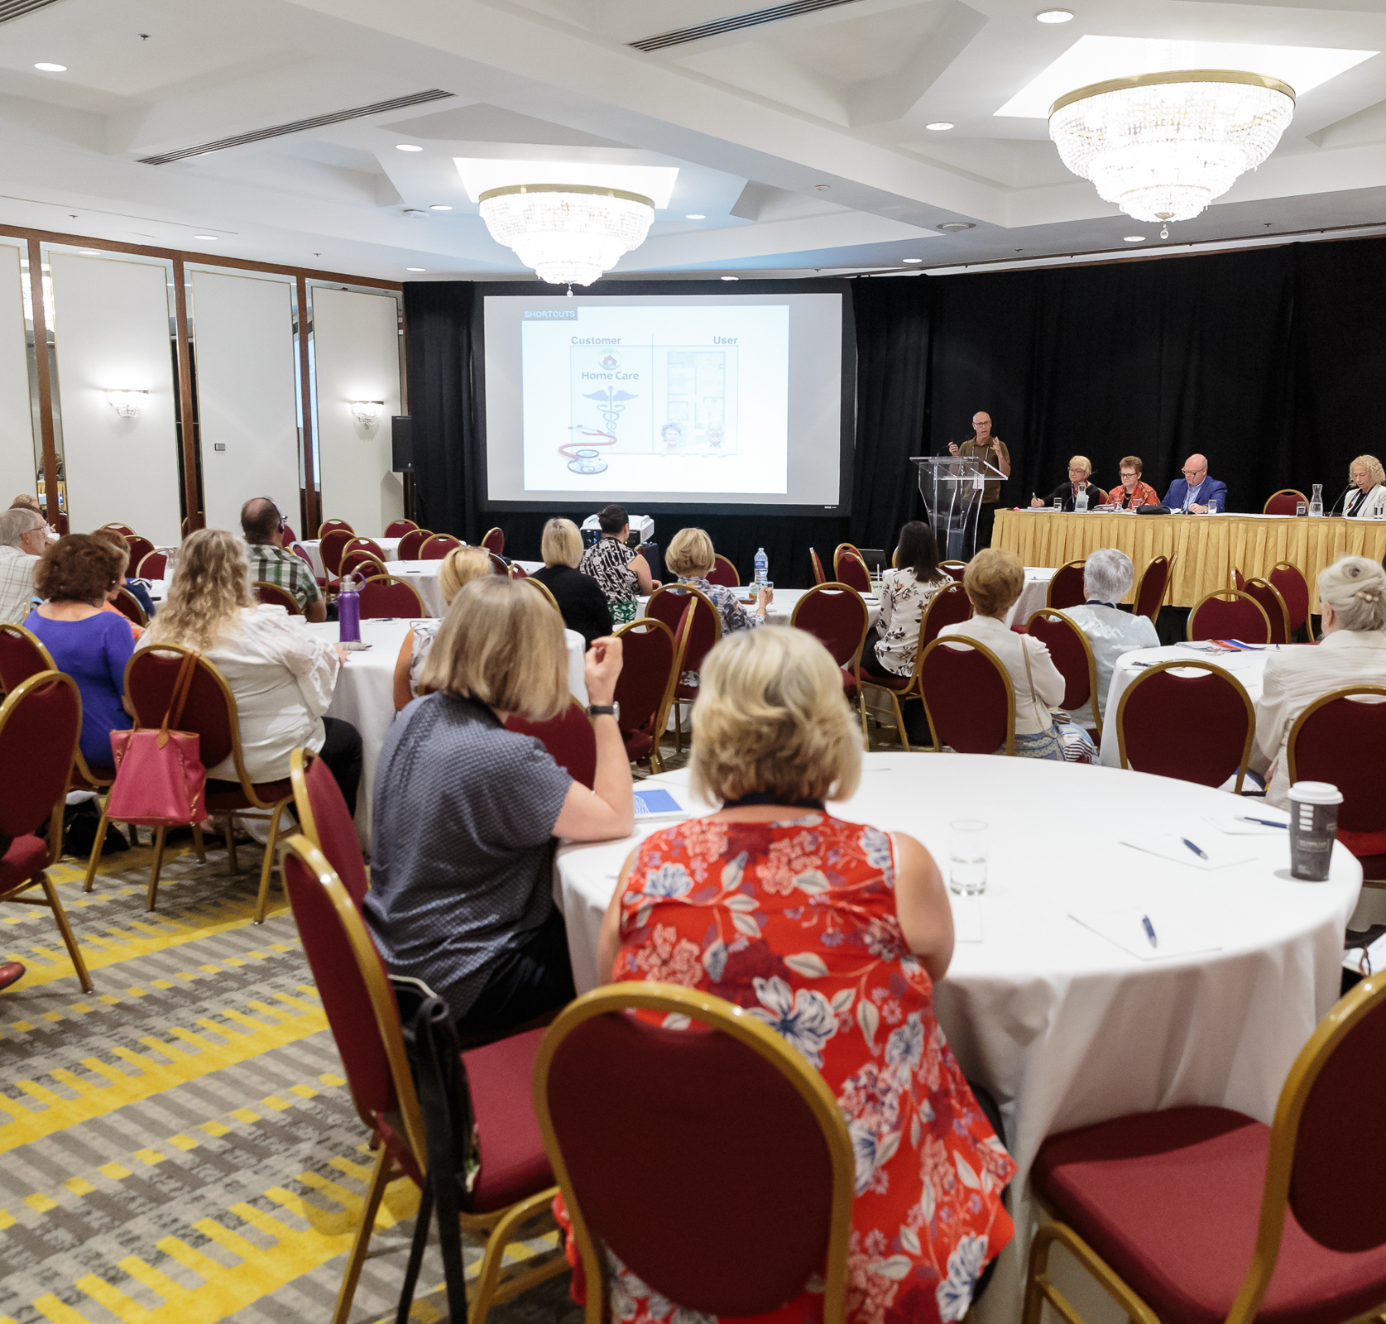
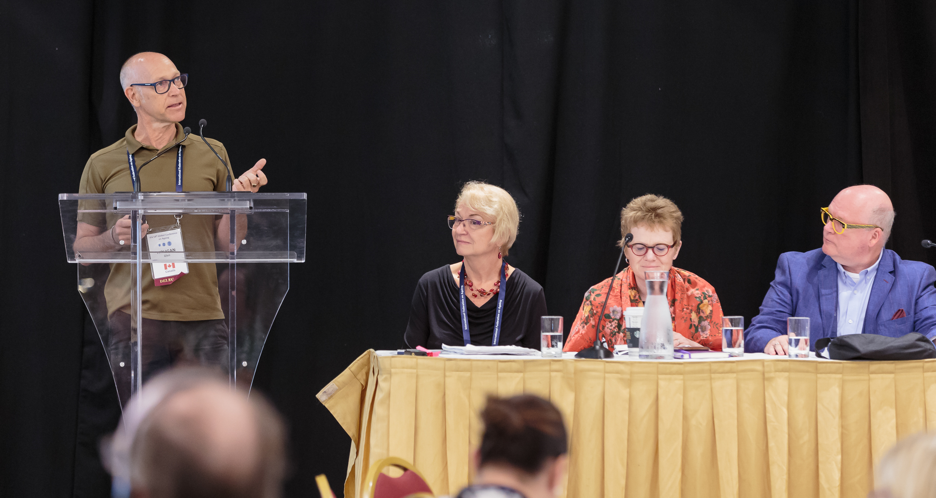
Age-friendly Symposia
Sessions 1-1.5hrs
3-4 speakers on a related AFCC theme

Slide 14
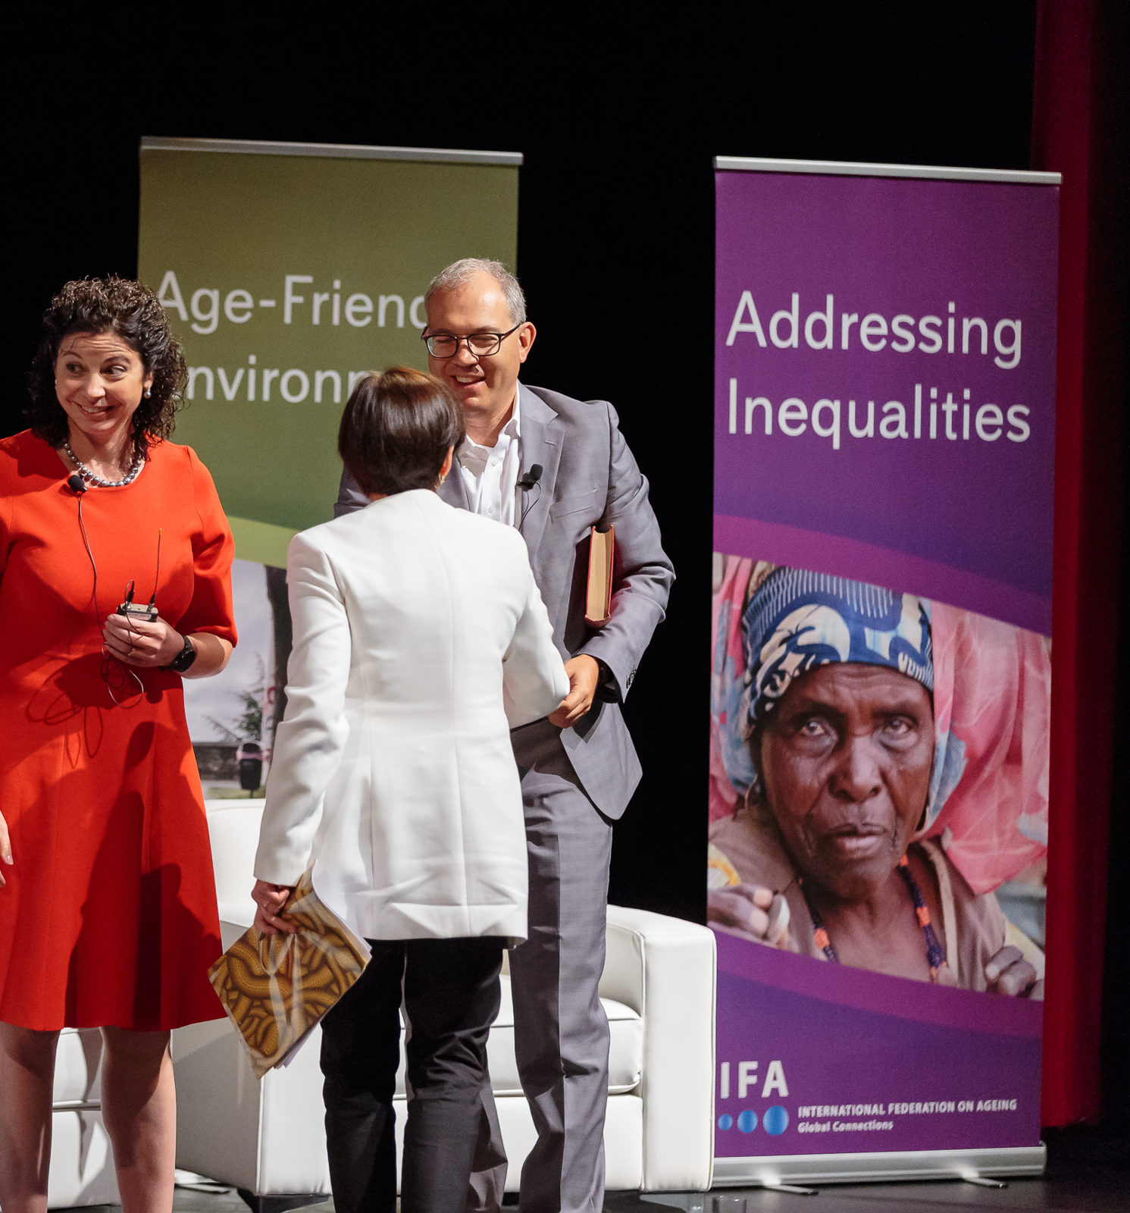
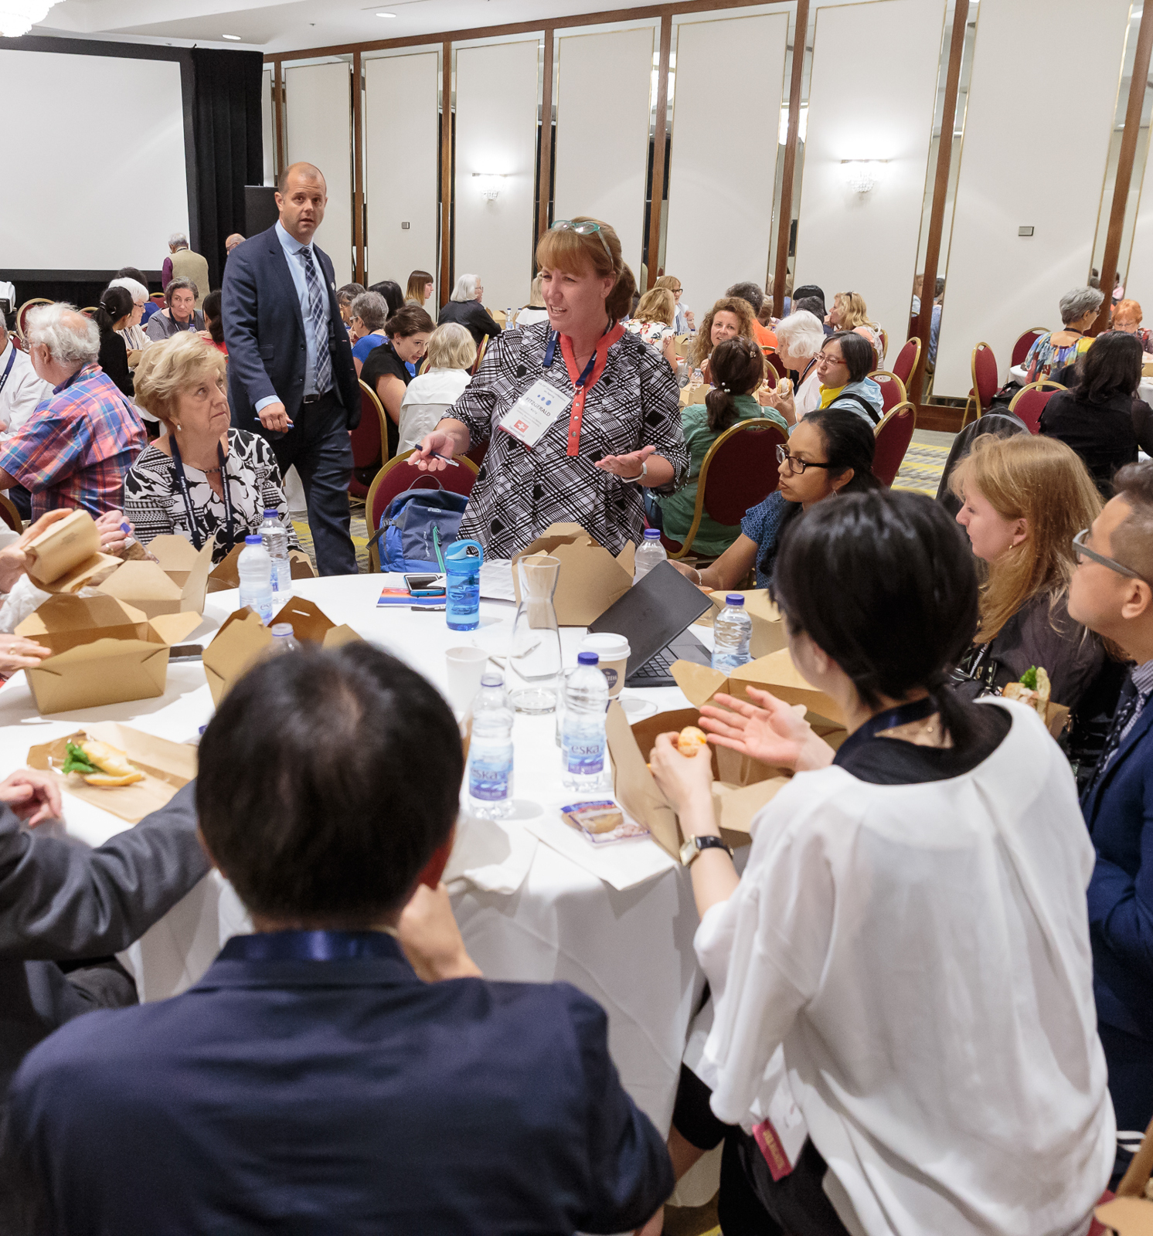
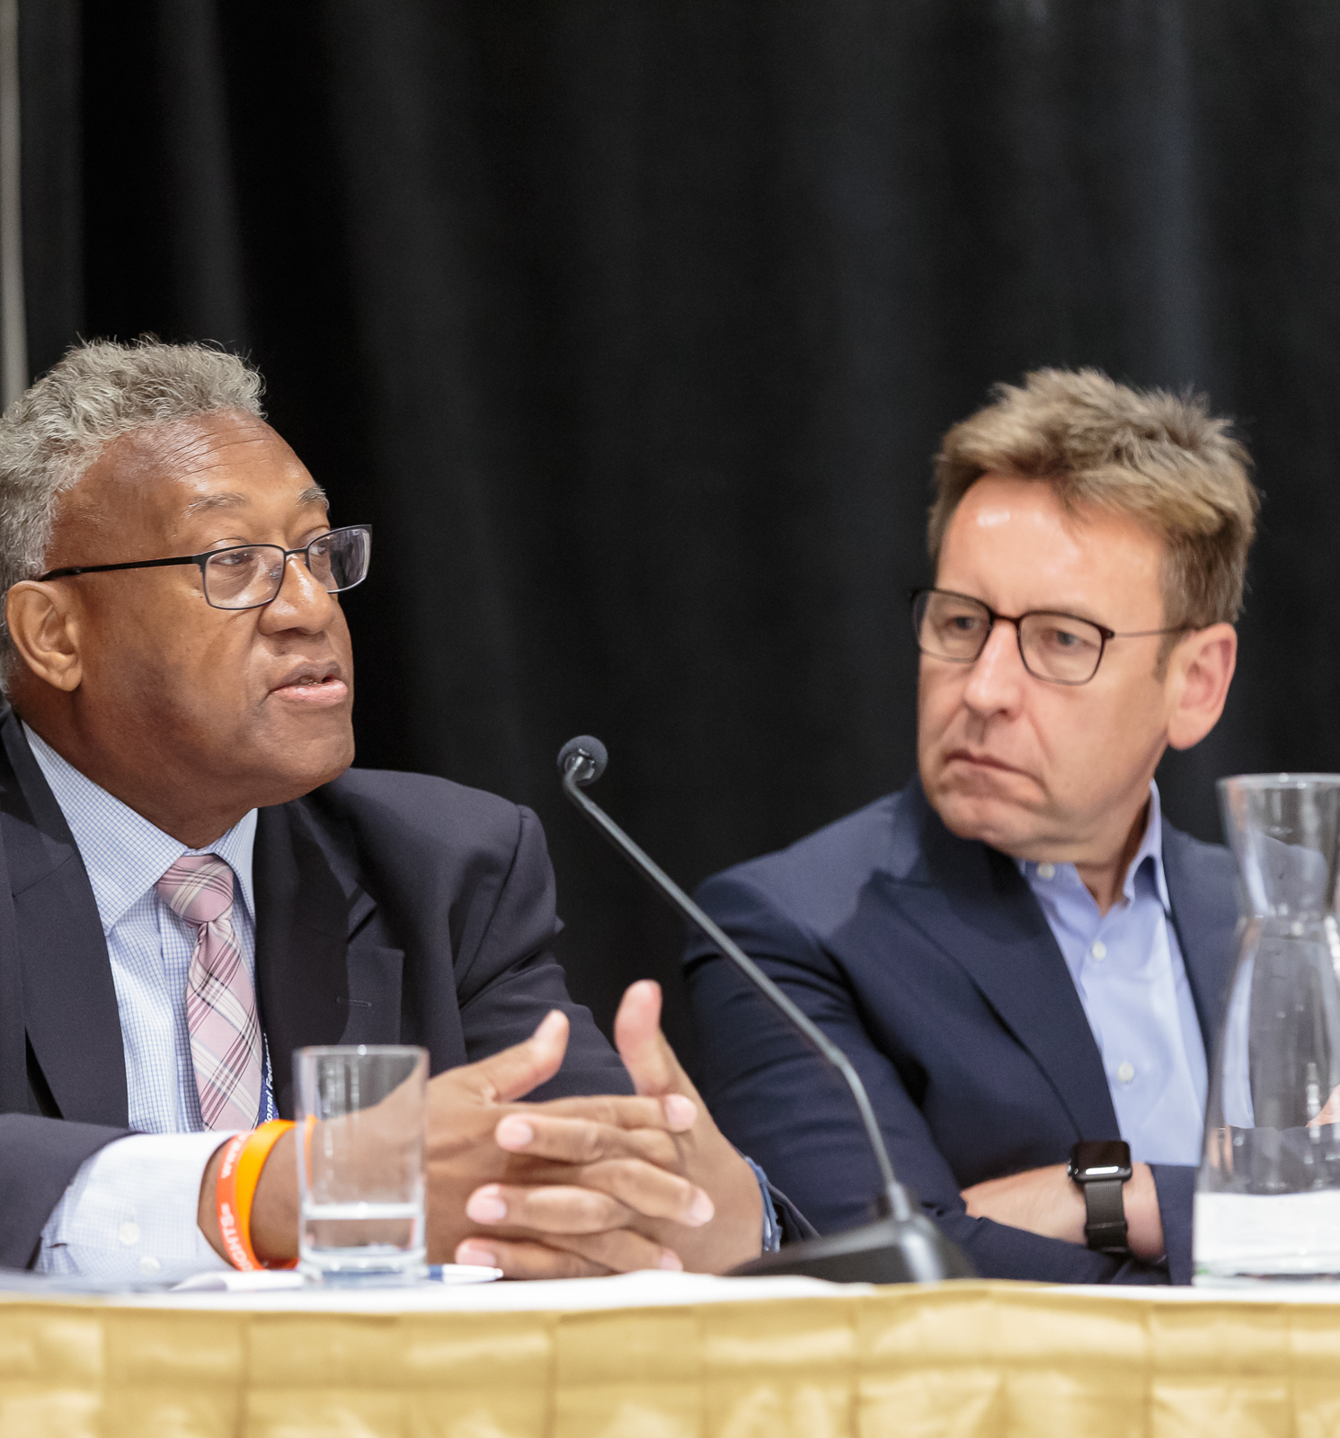
Age-friendly Workshops – Learning New Skills
1 – 1.5 hours - 2 facilitators

Slide 15
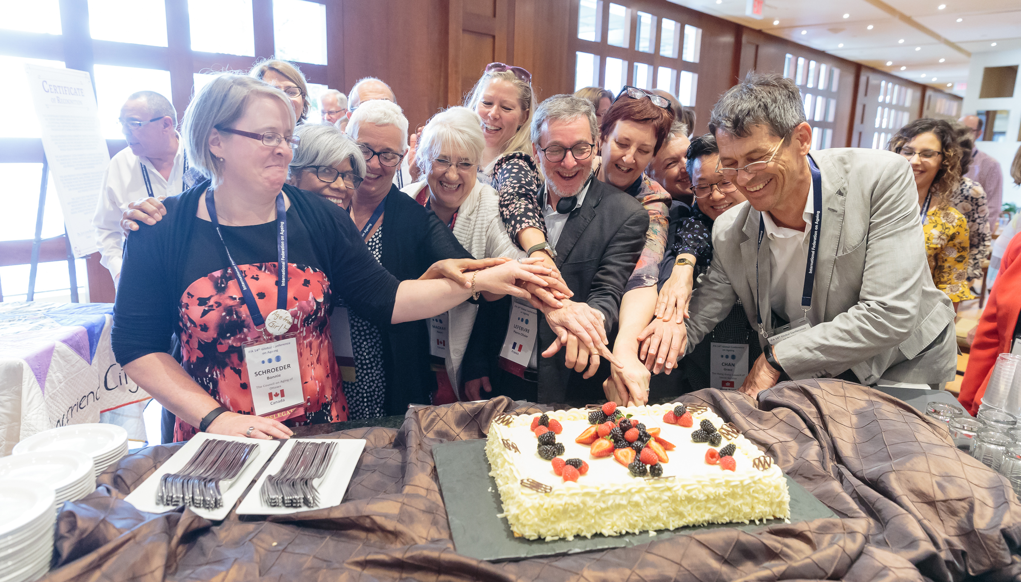
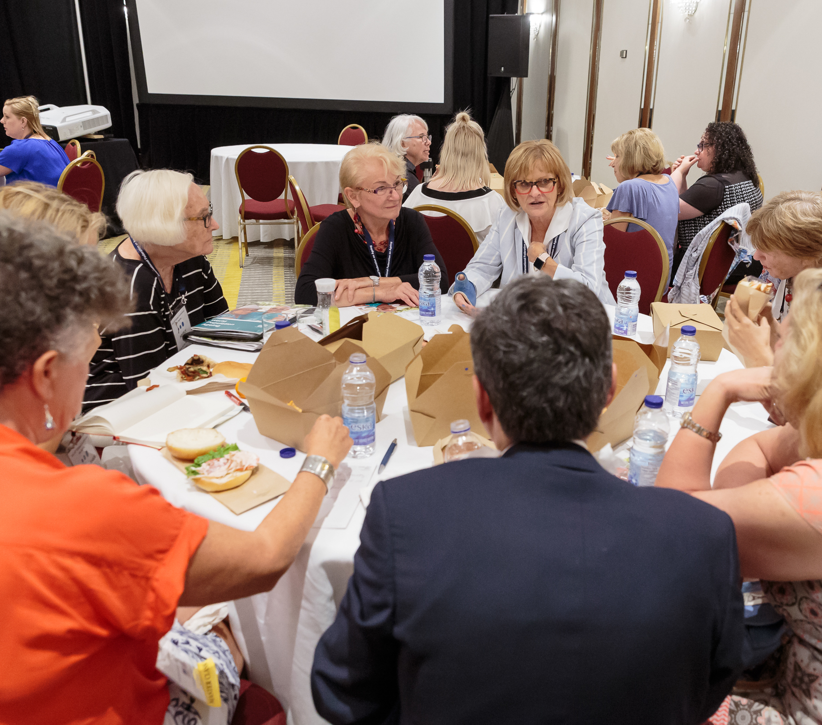

Slide 16


