Slide 1
SMART LIVING ENVIRONMENTS
FOR OLDER PEOPLE
ENABLING AGEING IN PLACE WITHOUT SOCIAL ISOLATION AND
WITH HIGHER LEVELS OF WELLBEING
IFA Global cafe
23 August 2024
www.smileehealth.eu

Slide 2
Scope of the SMILE project
Support ageing in place for older people by combining an innovative smart living environment (SLE) and a set of complementary eHealth solutions co-created with older people;
Innovate better ways of independent living for older people (and timely care and assistance when needed) at home.

Slide 3
Challenges
Many devices with different way to operate and use.
Challenge for all but also elderly
Challenge to support for the circle of care
Hard to collect data and do some smart with them across devices and services.
Access, quality - what and how, ….
Notes:
You get tied to a platform or device. It takes much resources to change to a better or cheaper and better solution.

Slide 4
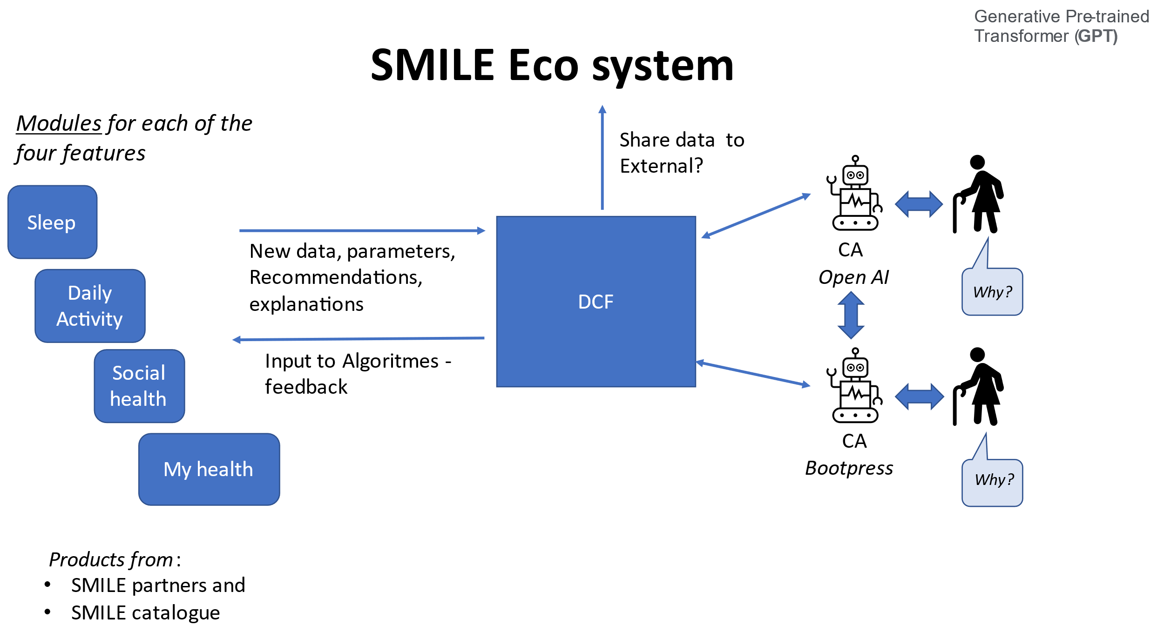
Architecture
Dashboard
CA – Conversation agent
DCF – Digital Care Facilitator

Slide 5
Conversational Agent

Slide 6


How to personalize CA?
Customizing the user interface based on a user's language preferences (e.g. Norwegian, Danish, English etc) or accessibility needs (e.g. text size, voice etc.).
Adapting “My health” feature based on user´s health literacy
Provide social activities based on user´s location, accessibility needs, preference of time etc. and send notification or reminders based on preference.
image: Flaticon.com
Notes:
Personalization in software design refers to the ability of a software application to tailor its user interface and functionality to the specific needs, preferences, and behaviors of individual users. This can be achieved through a variety of methods such as user profiles, machine learning algorithms, and user feedback.
Personalization can increase user engagement and satisfaction.

Slide 7
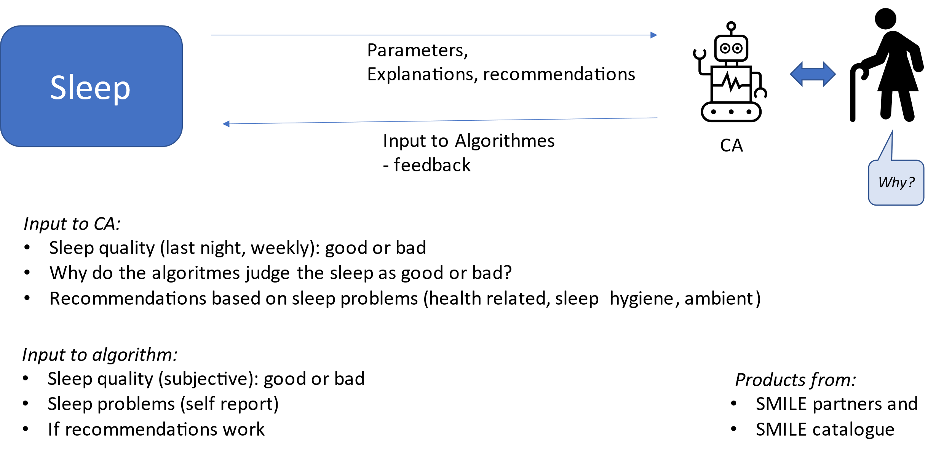

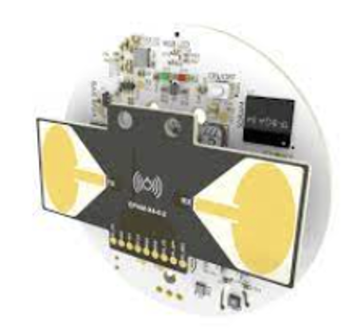
Sleep feature
good, medium, bad
very good, ok, not too bad, very bad

Slide 8
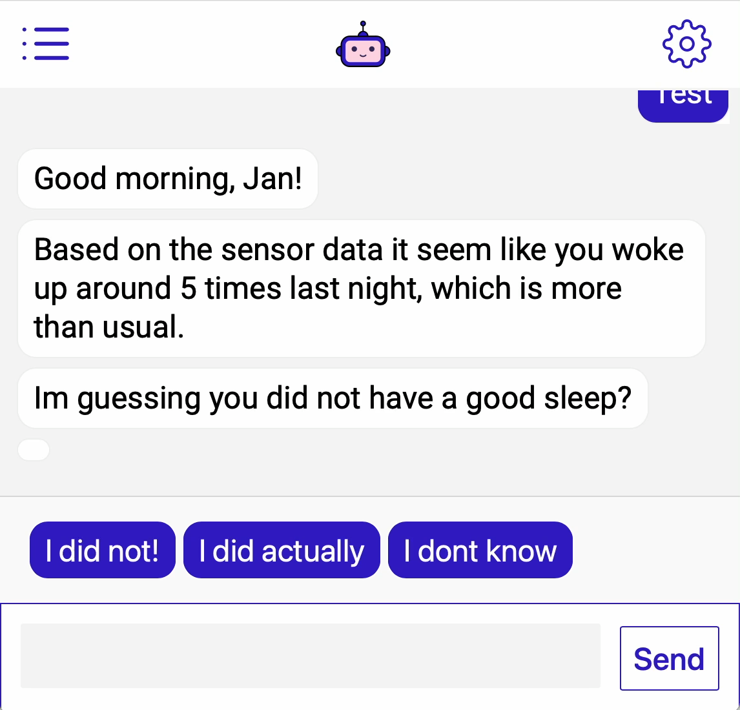
Example of the CA checking in with the user in the morning

Slide 9
Dashboard supporting informal caregivers of Persons with Dementia
www.smileehalth.eu

Slide 10
Aim & Objectives of Dashboard
Dashboard in collaboration with informal caregivers for persons with Dementia (PwD)
    Focused on supporting informal caregivers
    Structured approach within context of responsible innovation
    User-centred approach considering informal caregivers as primary end-users
    Understanding caregiver needs, wishes, and interaction with technology

Slide 11
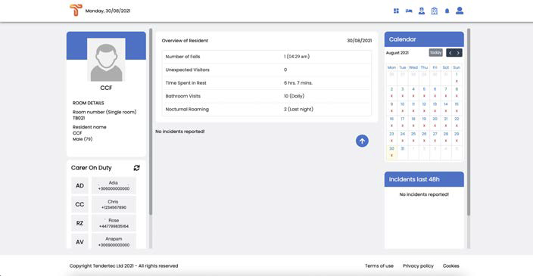
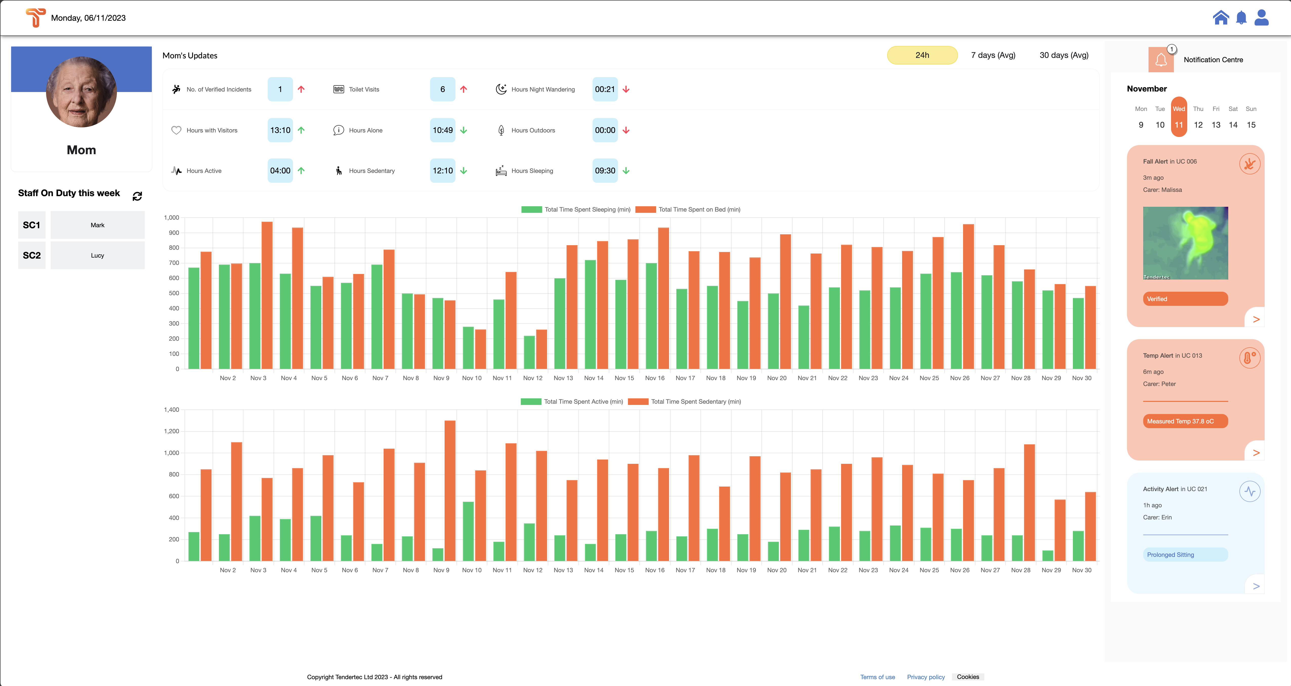
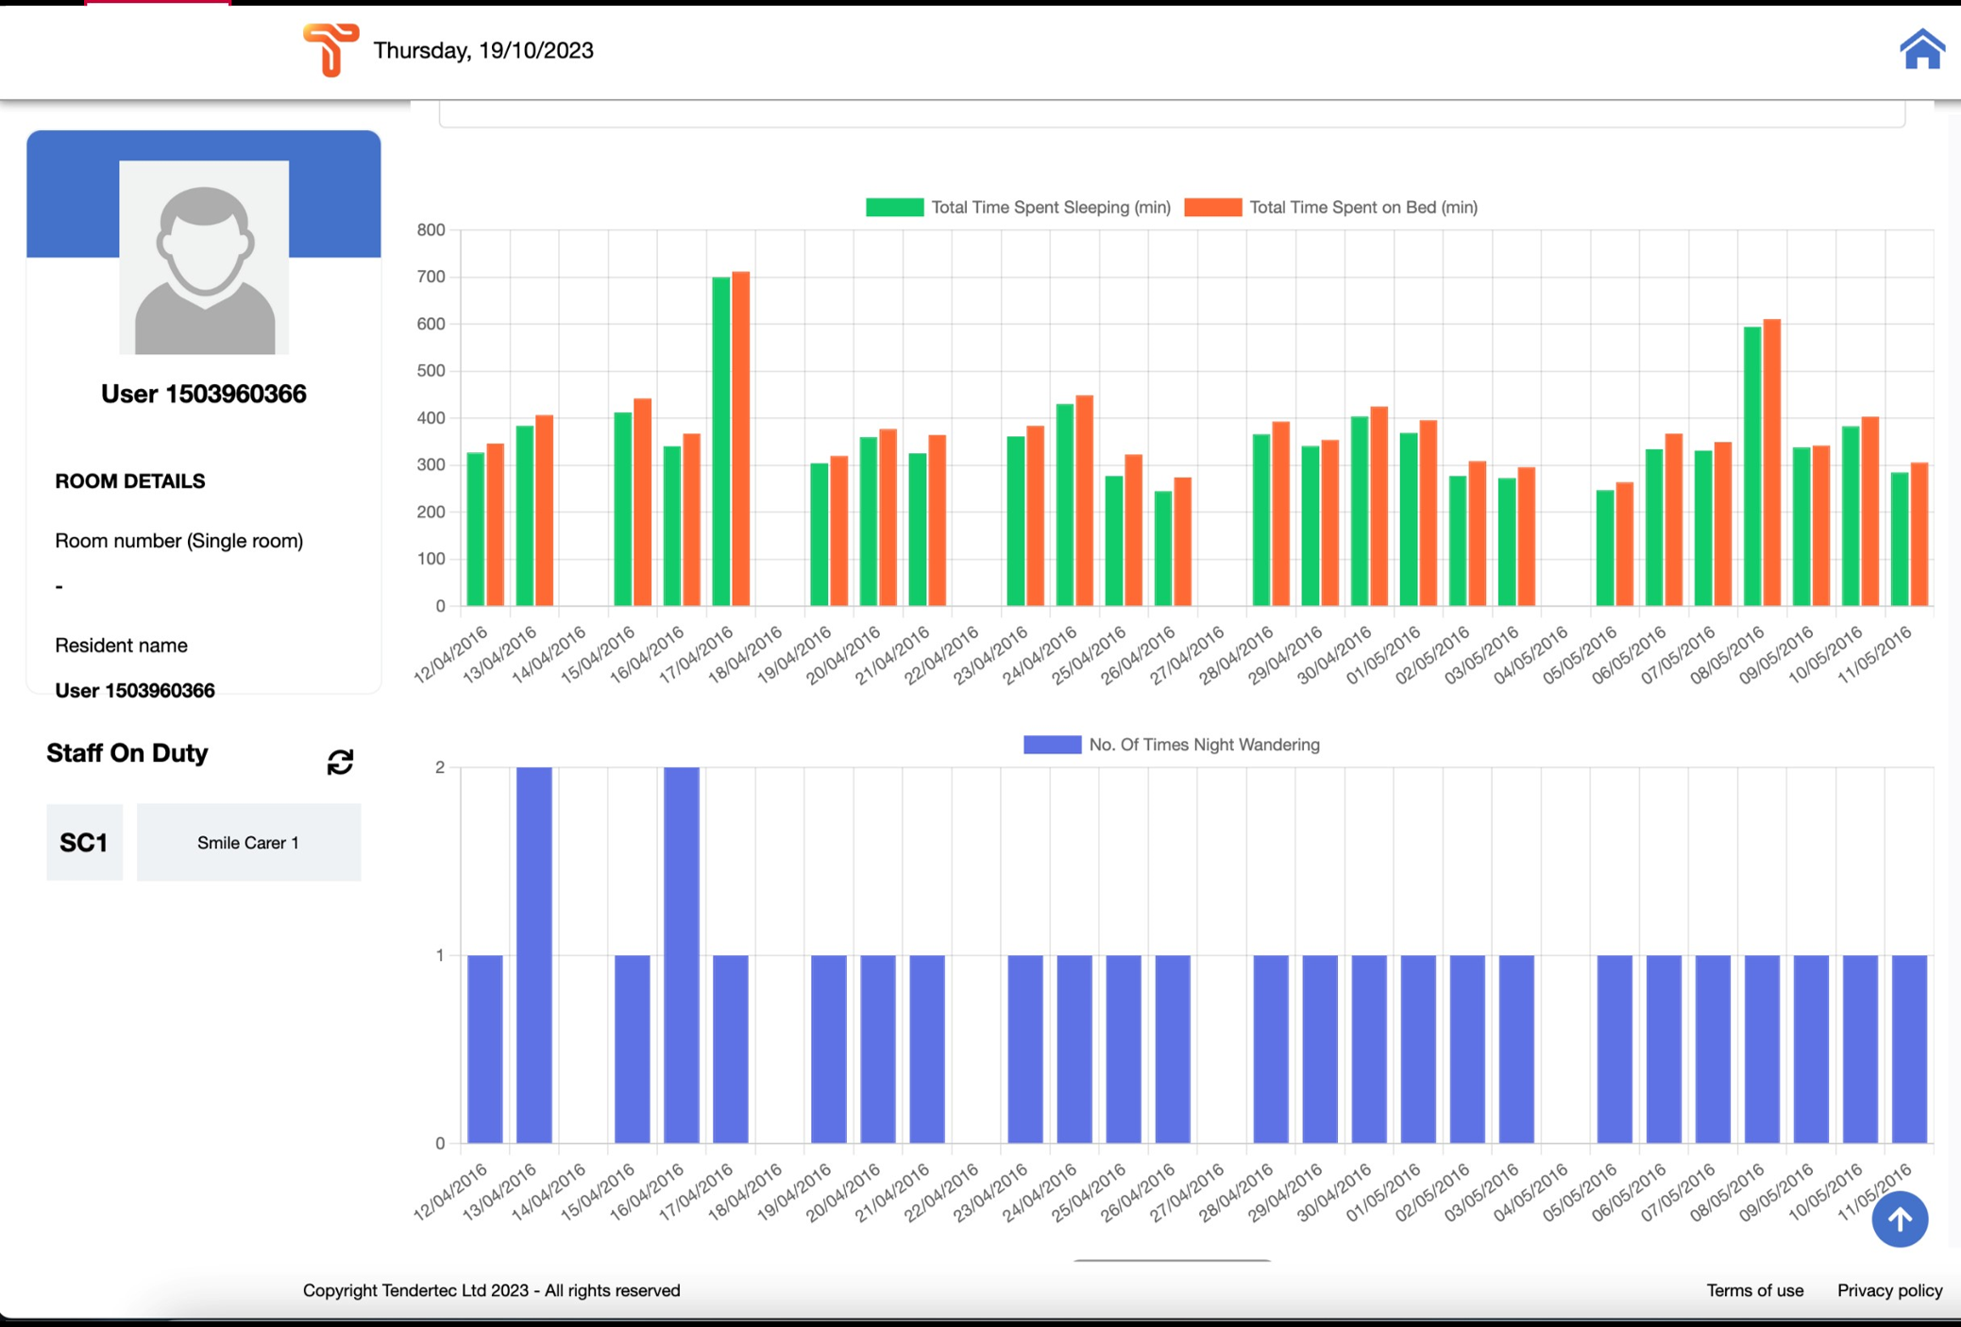
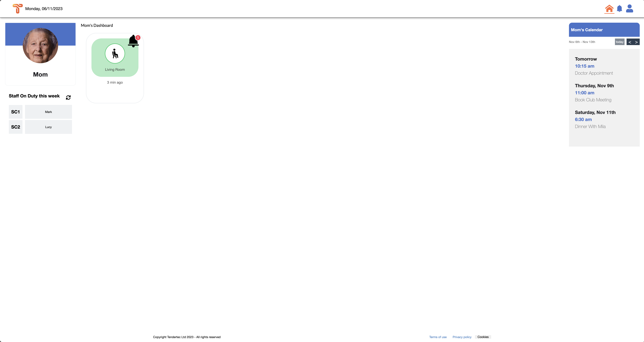
Dashboard – Iterative Design

Slide 12
Feedback & Learnings
Retained Skill: Dashboard assists caregivers in having a good view of daily activities and mid-term patterns.
Training: Interactive and intuitive design makes it easy to use
Acceptance: Dashboard's transparency builds trust among caregivers, being able to turn on/off data on graphs allows flexibility.
Technology: User-friendly design encourages positive perspectives towards technology adoption.
Experience: Dashboard enhances connectivity between caregivers and PwD, provides comprehensive overview of PwD’s condition.

Slide 13





CONTACT INFORMATION
Sverre Bergh, Ph.D., Innlandet Hospital Trust
Sverre.bergh@sykehuset-innlandet.no
www.smileehealth.eu
@smileehealth
https://www.linkedin.com/company/smile-horizon-2020-project/?viewAsMember=true

Slide 14



THANK YOU FOR YOUR ATTENTION!
This project has received funding from the European Union’s Horizon 2020 Research and Innovation programme, under Grant Agreement nº 101016848.
The SMILE Project is supported by the Canadian Institutes of Health Research (CIHR).

