Slide 1







SOCIAL MEDIA TOOLKIT
Age-Friendly Environments (AFE) ECHO Programme –
4th Edition
Webinar Series
Be part of this ground-breaking initiative focused on promoting age-friendly environments across all geographic regions.
Bi-weekly sessions
28 September – 23 November 2026
Live Sessions
For more information visit ifa.ngo/events/
Page 1

Slide 2




How to Use this Toolkit
Thank you for helping us amplify important conversations on age-friendly environments.
This toolkit provides you with ready-to-use assets and key messages to promote our upcoming ECHO Programme across your social media channels.
1. DOWNLOAD
Click on any asset preview to download the high-resolution file.
2. CUSTOMIZE
Feel free to adapt the suggested copy to fit your audience and voice.
3. SHARE
Post on your channels using the suggested copy, hashtags, and tagged accounts.
4. ENGAGE
Like, comment, and share to help us increase reach and impact.
KEY DATES
Webinar series runs from 28 September to 23 November 2026.
Check page 3 for the full schedule and assets.
REGISTRATION LINK
https://ow.ly/VuvE50ZnQx6
Click here to learn more about the Age-friendly Environments (AFE) ECHO Programme – 4th Edition.
Page 2

Slide 3


Social Media Assets
Click on any assets below to download.
DOWNLOAD
DOWNLOAD
Click here to learn more about the Age-friendly Environments (AFE) ECHO Programme – 4th Edition.
Page 3

Slide 4

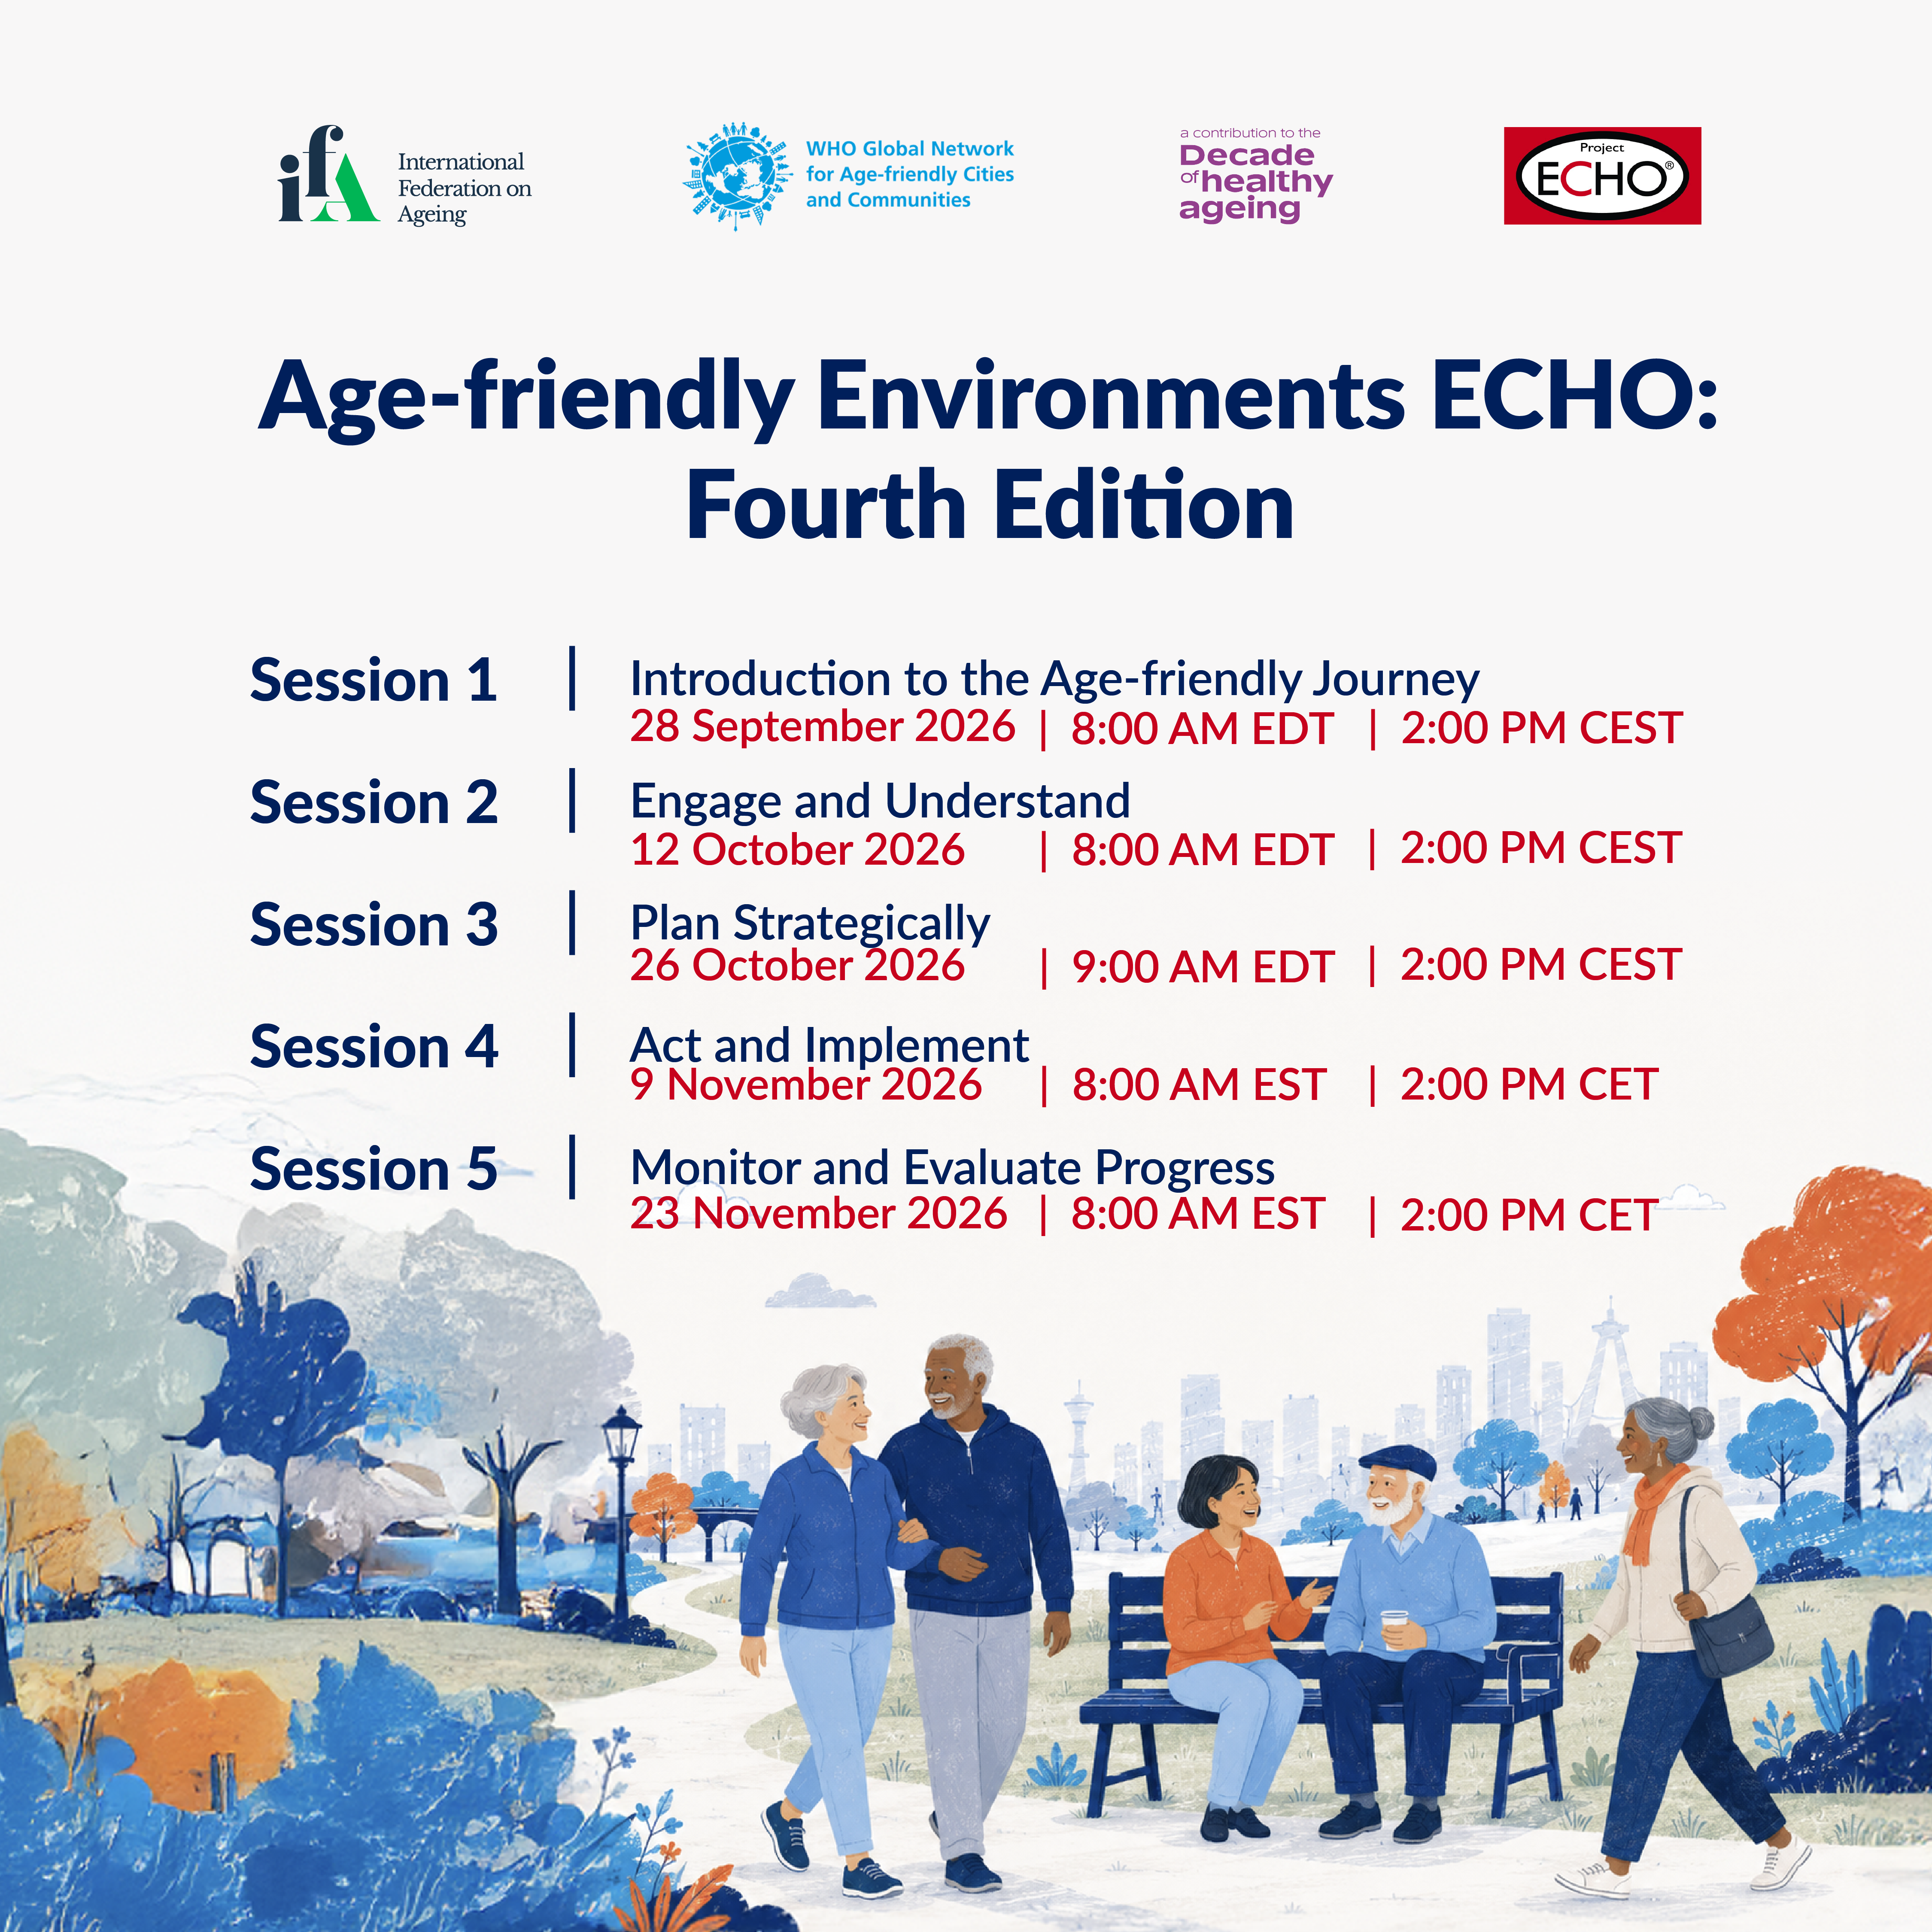
Social Media Assets
Click on any assets below to download.
DOWNLOAD
DOWNLOAD
Click here to learn more about the Age-friendly Environments (AFE) ECHO Programme – 4th Edition.
Page 4

Slide 5
Ready-to-Use Copy
Suggested social media copy to accompany the campaign assets. Partners are welcome to simply copy and paste the text below or adapt the messaging as appropriate for their audiences across LinkedIn and Facebook.
Copy | Characters
Are you an emerging leader of an age-friendly city/community or in a position to influence age-friendly community development? Are you interested in gaining the skills needed to lead, influence and implement age-friendly initiatives? Join the fourth edition of the WHO and IFA’s Age-friendly Environments ECHO, an opportunity to share knowledge and learn from experts and other learners. This edition will focus on promoting age-friendly environments across all regions! Register here: https://ow.ly/VuvE50ZnQx6 | ~313
The Age-friendly Environments ECHO returns for its fourth edition! This ground-breaking initiative fosters collaboration and knowledge sharing for all interested in advancing age-friendly programming. Emerging age-friendly leaders and community leaders interested in making their communities more age-friendly are encouraged to register today for this 5-session learning cycle. Open to all! Register here: https://ow.ly/VuvE50ZnQx6 | ~435
Click here to learn more about the Age-friendly Environments (AFE) ECHO Programme – 4th Edition.
Page 5

Slide 6
Ready-to-Use Copy
Suggested social media copy to accompany the campaign assets. Partners are encouraged to adapt the messaging as appropriate for their audiences across LinkedIn, Facebook and X (formerly Twitter).
Copy | Characters
Are you an emerging or established leader of an age-friendly city or community? Register for the WHO and IFA-led Age-friendly Environments ECHO Mentorship Program and help to create a network of individuals and organizations with the goal of prioritizing the development and implementation of age-friendly environments around the world! Register here: https://ow.ly/VuvE50ZnQx6 | ~ 391
Note: The copy below is suggested for X (formerly Twitter) and has been written to fit within the platform's character limit.
Boost your knowledge as an emerging or established leader in age-friendly communities through the Age-friendly Environments ECHO. Register now for this innovative 5-session learning cycle! Register here: https://ow.ly/VuvE50ZnQx6 | ~ 232
Click here to learn more about the Age-friendly Environments (AFE) ECHO Programme – 4th Edition.
Page 6

Slide 7
Suggested Hashtags
Partners are encouraged to use the hashtags below to help increase the visibility and reach of campaign posts. Feel free to include those most relevant to your audience.
Keep it to 5–7 hashtags per post as that tends to read more naturally across LinkedIn, Facebook, and X.
#agefriendly
#AgeFriendlyCities
#AgeInCommunity
#AgeFriendlyDesign
#HealthyAging
Click here to learn more about the Age-friendly Environments (AFE) ECHO Programme – 4th Edition.
Page 7

Slide 8




THANK YOU
for being part of this important conversation.
Together, we can build longevity-ready societies.
FOLLOW US ON SOCIAL MEDIA
ifa.ngo/events/
Page 8

